Slide 1
WHAT IS A
MNEMONIC DEVICE??
Free Powerpoint Templates

Slide 2
Preview/Review: 10-2-15
Question: What is a Mnemonic Device ?
Target: I can create a mnemonic device.
Think: What is the purpose of a mnemonic Device?
Pair - Share

Slide 3
What is a Mnemonic Device ?
Definition:
A mnemonic is a device that allows for easy storage and simple retrieval of information from your long-term memory.
HINT: People tend to remember the unusual, the funny and/or the personal ones the best.

Slide 4
Types of Mnemonic Devices:
1. Acronyms
The most common everyday use of mnemonics. The first letter from each word is taken to spell out a simple word or phrase
ROY G BIV
Red Orange Yellow Green Blue Indigo Violet
COLORS OF THE RAINBOW

Slide 5
Types of Mnemonic Devices:
2. Acrostic
An invented sentence where the first letter of each word is a cue to an idea you need to remember.
Please Excuse My Dear Aunt Sally
Math: Order of Operations
(Parentheses, Exponent, Multiply, Divide, Add, Subtract.)

Slide 6
Types of Mnemonic Devices:
3. Rhymes
Placing the facts to be memorized into a rhyme or poetry form.
The Alphabet Song

Slide 7
Types of Mnemonic Devices:
4. Visual Association 1
Involves linking two ideas using images. This allows you to remember sequences of unrelated items in the appropriate order.
Pineapple
Cowboy hat
Bottle
Pencil
Car MEMORIZE THESE
George Washington TEN WORDS IN
Candy Bar ORDER
Computer
Lifeguard Chair
Sock

Slide 8
Pineapple
Cowboy hat
Bottle
Pencil
Car
George Washington
Candy Bar
Computer
Lifeguard Chair
Sock

Slide 9
Types of Mnemonic Devices:
4. Visual Association 1
Use Connector Words to associate two items
1. Bun
2. Shoe
3. Tree
4. Door
5. Hive These are
6. Sticks connector words
7. Heaven
8. Gate
9. Vine
10. Hen

Slide 10
1. Bun
2. Shoe
3. Tree
4. Door
5. Hive
6. Sticks
7. Heaven
8. Gate
9. Vine
10. Hen
Pineapple
Cowboy hat
Bottle
Pencil
Car
George Washington
Candy Bar
Computer
Lifeguard Chair
Sock

Slide 11
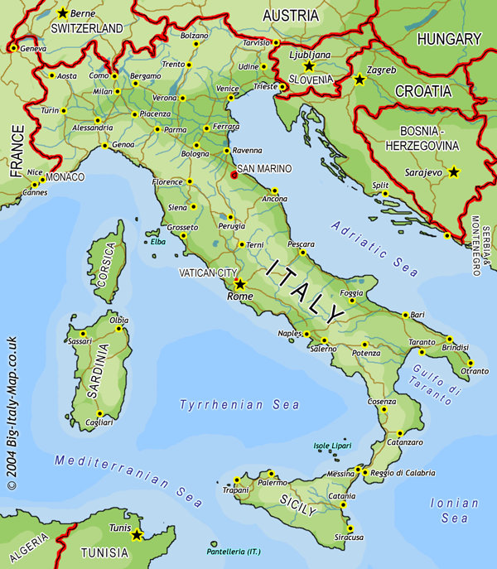
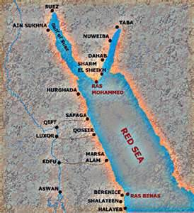
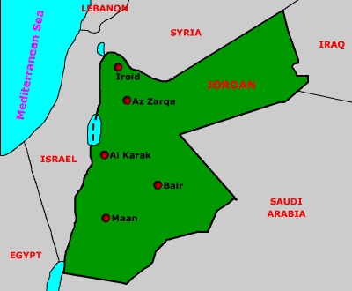
Types of Mnemonic Devices:
5. Visual Association 2
Involves linking a picture with the item you need to remember
Italy looks like a boot
Jordan looks like a lady’s head
The Red Sea looks like a peace sign or snail

Slide 12
Types of Mnemonic Devices:
6. Chunking
Involves reducing items that you need to memorize into organized groupings.
Example: Phone number
74177691120011271941112000

Slide 13
Types of Mnemonic Devices:
6. Chunking
Involves reducing items that you need to memorize into organized groupings. Example: Phone number
7-4-1776 / 9-11-2001 / 12-7-1941 / 1-1-2000

Slide 14
What is a Mnemonic Device ?
Practice with Spelling:
Europe
E U ROPE

Slide 15
What is a Mnemonic Device ?
Practice with Spelling:
Australia
A us trali a
The “i” left the trail

Slide 16
What is a Mnemonic Device ?
Practice with Spelling:
Mediterranean Sea
Med it ERR!!! an e an

