Slide 1
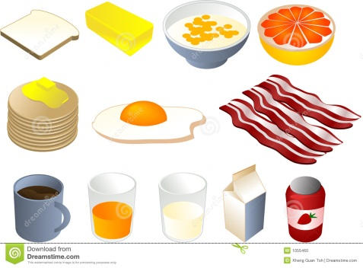
Breakfast: Most Important Meal of the Day

Slide 2
Breakfast should provide 25% of protein, calcium, iron, Vitamin A, Vitamin C, and calories
Breakfast should provide complex carbohydrates for energy, protein and fats to help you feel full, whole grains for fiber
Breakfast should be low in fats, high in fiber to prevent the mid morning slump.(Feeling sluggish, headache, nausea, lack of concentration)
Skipping breakfast can make you feel tired, irritable, or sad. Even grabbing some fresh fruit or a bowl of cereal can help boost your mood.
Eating Breakfast can decrease likelihood of getting diabetes and helps maintain healthy weight.

Slide 3
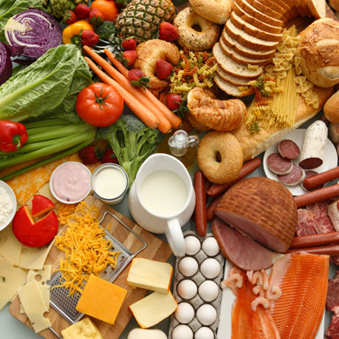
Good choices for breakfast:
fruits and vegetables
whole grain bread and cereals
low fat dairy products
low fat protein products

Slide 4
Protein: essential nutrients for the human body. They are one of the building blocks
of body tissue, and can also serve as a fuel source. As a fuel, proteins contain 4cal per gram.
Good sources include seafood, white meat poultry, low fat milk, cheese and yogurt, beans,
soy, lean red meats.
Iron: Iron is an essential nutrient that carries oxygen and forms part of the
oxygen-carrying proteins, hemoglobin in red blood cells and myoglobin in muscle.
It is also a necessary component of various enzymes. Good sources include red meats,
(easily absorbed), dark green leafy vegetables, grains, eggs, fruits

Slide 5
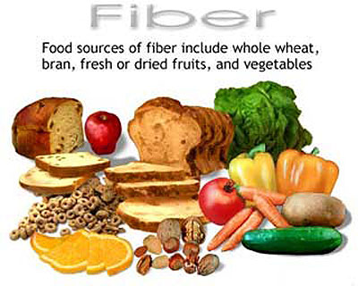
Fiber: Coming in thousands of forms, fiber is a term for all parts of plant foods the body cannot digest. Found in all fruits and vegetables, as well as whole grains and legumes, fiber travels through the body without breaking down. It passes through the body and makes a quick exit. Though fiber is not absorbed by the body, it has a variety of health benefits, such as assisting in weight loss and constipation and helping regulate various gastrointestinal disorders. Good sources include whole grains, nuts, legumes, fruits and vegetables
Calcium: The mineral calcium is well-known for its key role in bone health.
Calcium also helps maintain heart rhythm, muscle function, and more.
Because of its health benefits, calcium is one of the best-selling supplements in the U.S.Good sources include low fat dairy products, dark green leafy vegetables, food fortified with calcium like juices and breads

Slide 6
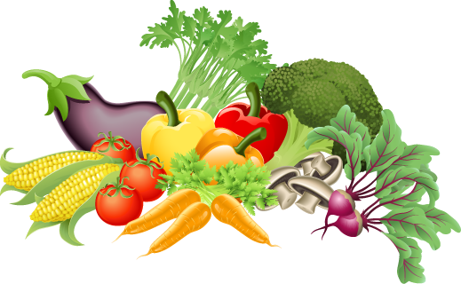
Vitamin A: fat-soluble vitamin that is naturally present in many foods. Vitamin A is important for normal vision, the immune system, and reproduction. Vitamin A also helps the heart, lungs, kidneys, and other organs work properly.
Good sources include dark red and orange vegetable, liver, and fortified food products
Vitamin C: Vitamin C is a water-soluble vitamin that is naturally present in some foods, added to others, and available as a dietary supplement.
Vitamin C (ascorbic acid) is a water-soluble vitamin, which is needed by the body to form collagen in bones, cartilage, muscle, and blood vessels. Good sources include citrus fruits , broccoli, and fortified foods

