Slide 1
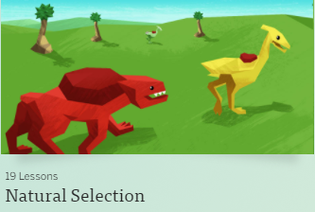
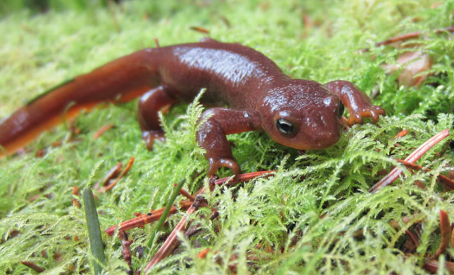
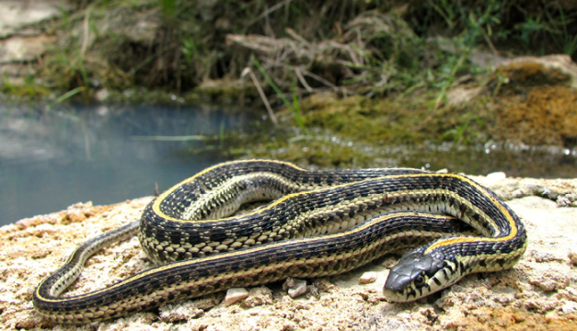
Chapter 2 – Natural Selection and Reproduction

Slide 2
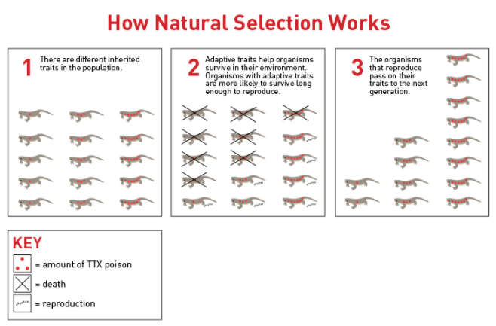
2.4.1: WARM-UP
Revisit the visual representation from “The Deadly Dare” and prepare for your second read.

Slide 3
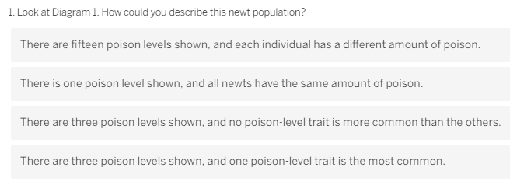
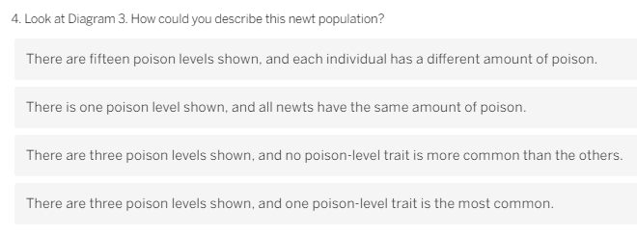
2.4.1: WARM-UP
Revisit the visual representation from “The Deadly Dare” and prepare for your second read.
YES
YES

Slide 4
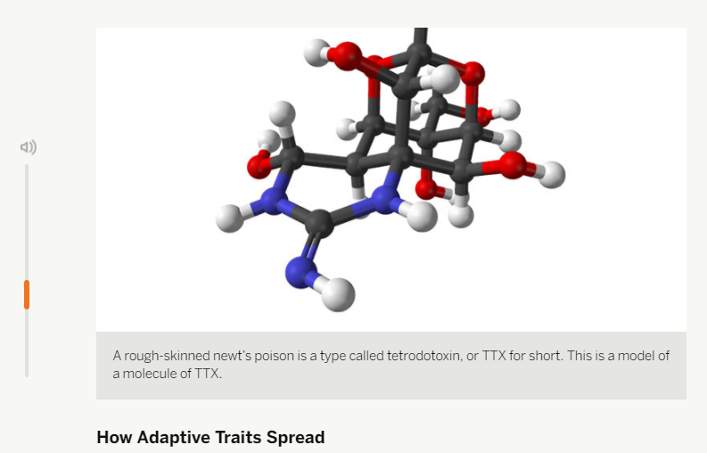
2.4.2: Reading
Rereading “The Deadly Dare”
Reread part of the article you read in the previous lesson, with a focus on looking for information that will help you answer the Chapter 2 Question. (20 min)
Use a different color than the one you used in the previous lesson to identify information that helps answer the questions next to the article.
Today, you will read part of “The Deadly Dare” once more in order to find evidence to answer questions from Alex Young.

Slide 5
2.4.2: Reading
Rereading “The Deadly Dare”
Answer Questions at the end of article on 2.4.2

Slide 6
2.4.2: Reading
Rereading “The Deadly Dare”
The individuals most likely to die before reproducing are those with non-adaptive traits, because their non-adaptive traits make it hard for them to survive. In the newt population, the newts with low poison died because they couldn’t escape their predators, the snakes.
If most individuals with a specific trait die before reproducing, that trait will decrease and/or be eventually eliminated from the population because no parents are passing on that trait to their offspring.

Slide 7
2.4.2: Reading
Rereading “The Deadly Dare”
There are more individuals with high-poison levels in the newt population in Diagram 3 because high poison is an adaptive trait. Individuals with adaptive traits (high-poison levels) were able to survive and reproduce more than individuals with low-poison levels. Over generations, this led to more newts with high-poison levels. This process of change in the distribution of traits in a population over time is called natural selection.
The newts in the population in Diagram 3 are not the oldest newts. I know this because in Diagram 2, there were only four newts with high poison. All of them reproduced, and in Diagram 3, there were eight newts with high poison. Some of the newts in Diagram 3 might be the oldest newts, but the trait is not becoming more common simply because newts with that trait aren’t dying; it’s more common also because the newts with this trait are passing their traits onto the most offspring.

Slide 8
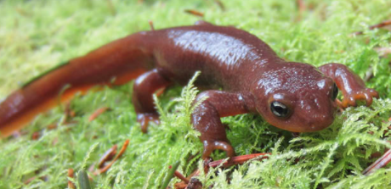
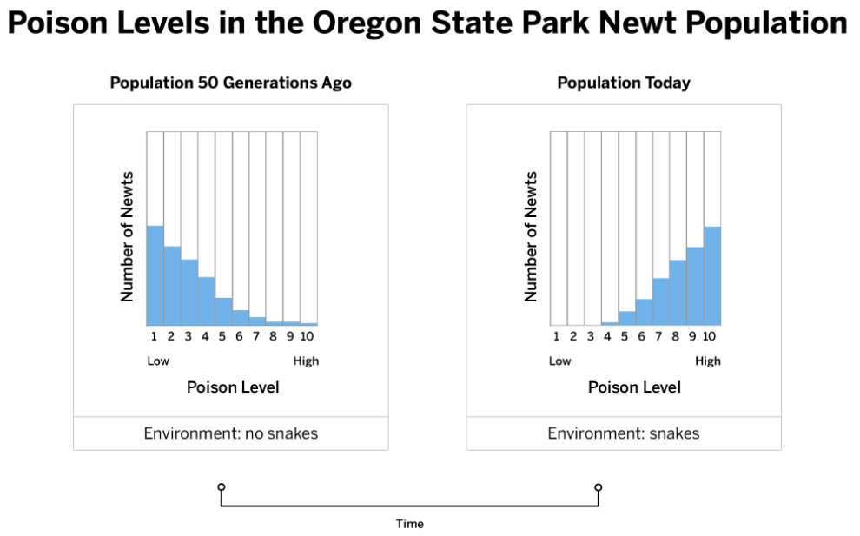
2.4.2: Reading
Rereading “The Deadly Dare”
Connecting to the claims about the newts.
Now that we understand more about the process of natural selection, we are ready to answer the Chapter 2 Question:
How did the trait for increased poison level become more common in the newt population?
In order to do this, we will take another look at the claim additions and see which one is best supported by evidence. This will help us make the most complete and accurate explanation.

Slide 9
2.4.2: Reading
Rereading “The Deadly Dare”
Let’s consider the questions on your screens.
Take a few minutes to read and respond to the question and the poll.
Add more detail to this statement to make it more accurate: “The less poisonous newts died and the more poisonous ones lived.” (Hint: Start with “The less poisonous newts . . . and the more poisonous ones . . .”)
The newt population became more poisonous because the snakes in this environment caused poison to be an adaptive trait. Which claim addition provides the most accurate explanation for this change?

Slide 10
2.4.2: Reading
Rereading “The Deadly Dare”
Let’s consider the questions on your screens.
Add more detail to this statement to make it more accurate: “The less poisonous newts died and the more poisonous ones lived.” (Hint: Start with “The less poisonous newts . . . and the more poisonous ones . . .”)
The newt population became more poisonous because the snakes in this environment caused poison to be an adaptive trait. Which claim addition provides the most accurate explanation for this change?
The less poisonous newts died before they could pass their traits onto very many offspring and the more poisonous ones lived longer, which meant they had more chances to reproduce, which meant that in the next generation most newts inherited their traits from parents who also had high-poison levels.
C is the best option since an accurate claim is a combination of A and B.

Slide 11
2.4.2: Reading
Rereading “The Deadly Dare”
Let’s discuss the question and poll results
“The less poisonous newts died and the more poisonous ones lived.”
Who can explain what this statement means, in their own words?
This statement is saying that less poisonous newts get eaten and more poisonous newts don’t. The more poisonous ones just keep living, so there are more of them.
Yes — and that’s not untrue, but it’s not the whole story, either.
What else is happening?
Adaptive traits are becoming more common because individuals with adaptive traits reproduce more and pass on their traits.
Non-adaptive traits are becoming less common because individuals with non-adaptive traits are more likely to die without reproducing.

Slide 12
2.4.2: Reading
Rereading “The Deadly Dare”
Project the poll results
Why is it that neither claim addition is completely accurate on its own.
Neither claim addition is a complete explanation. The newts with high-poison levels don’t live forever, and they can’t reproduce quickly.
Create a claim that is more accurate.
Talk with your partners/table to generate ideas.
You can use your responses to the short-answer question to help.

Slide 13
2.4.2: Reading
Rereading “The Deadly Dare”
Notes:
If possible, use the words your students suggested to show that this revised claim reflects their thinking and learning.

Slide 14
2.4.2: Reading
Rereading “The Deadly Dare”

Slide 15
2.4.2: Reading
Rereading “The Deadly Dare”

Slide 16
2.4.3: Student Discussion
Reasoning About the Rough-Skinned Newts

Slide 17
2.4.3: Student Discussion
Reasoning About the Rough-Skinned Newts
Alex Young is eager to share our findings with the scientific community.
We will continue to prepare to write an argument for the claim we think is best supported by using the Reasoning Tool.
The Reasoning Tool will help us connect the evidence we have collected from the histograms and the article to a claim about why the newt population has changed so much.

Slide 18
2.4.3: Student Discussion
Reasoning About the Rough-Skinned Newts
Remember that reasoning is the process of connecting evidence to a claim in a scientific argument.
Scientists use what they know about science to make these connections, and it is an important practice of science to make reasoning clear in a scientific argument.
It can be challenging to clearly say how evidence supports or goes against a claim; however, the process of reasoning is what strengthens a scientific argument or explanation.

Slide 19
2.4.3: Student Discussion
Reasoning About the Rough-Skinned Newts
You will use the Reasoning Tool to connect the evidence you have collected to your newly revised claim.
Evidence is already written down
Even if you feel sure about this claim, you still have more work to do: it is not sufficient to simply tell Alex Young which claim is supported by the evidence, you need to explain why that claim is supported by the evidence.
Without this explanation, your arguments would not be convincing.
The Reasoning Tool will help you with this important thinking.

Slide 20
2.4.3: Student Discussion
Reasoning About the Rough-Skinned Newts
Using our claim in our Reasoning Tool:
A. Sometime between 50 generations ago and today, snakes became part of this newt population’s environment.
“The newt population became more poisonous because the snakes in this environment caused poison to be an adaptive trait,
and"
"Poison Level 10 is the most common because the newts with this trait were able to live longer and reproduce more than other newts.”

Slide 21
2.4.3: Student Discussion
Reasoning About the Rough-Skinned Newts
Why this evidence matters…connecting the evidence to the claim.
The reasoning or thinking I'd need to do to connect this evidence to our new claim has to do with what I know about environments and how they cause different effects in populations.
Therefore, this statement is evidence that the newts are likely to experience natural selection due to the predators in their environment.
It helps me to start building a case about why Poison Level 10 is the most common.
“The newt population became more poisonous because the snakes in this environment caused poison to be an adaptive trait, and Poison Level 10 is the most common because the newts with this trait were able to live longer and reproduce more than other newts.”
A. Sometime between 50 generations ago and today, snakes became part of this newt population’s environment.
“The newts that are the most common are the ones that have adaptive traits to help them avoid being killed by snakes.”

Slide 22
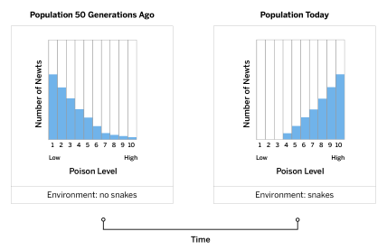
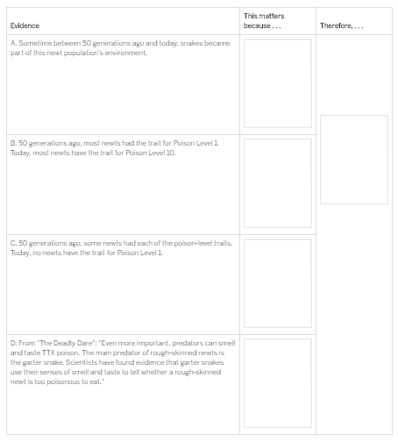
2.4.3: Student Discussion
Reasoning About the Rough-Skinned Newts
Complete the Reasoning Tool.
Remember that you can use the key concepts posted on the wall!
Be ready to share your ideas

Slide 23
2.4.3: Student Discussion
Reasoning About the Rough-Skinned Newts
A. EVIDENCE – Example
A. Sometime between 50 generations ago and today, snakes became part of this newt population’s environment.
“The newt population became more poisonous because the snakes in this environment caused poison to be an adaptive trait, and Poison Level 10 is the most common because the newts with this trait were able to live longer and reproduce more than other newts.”
“The newts that are the most common are the ones that have adaptive traits to help them avoid being killed by snakes.”

Slide 24
2.4.3: Student Discussion
Reasoning About the Rough-Skinned Newts
B. EVIDENCE – Example
B. 50 generations ago, most newts had the trait for Poison Level 1. Today, most newts have the trait for Poison Level 10.
“The newt population became more poisonous because the snakes in this environment caused poison to be an adaptive trait, and Poison Level 10 is the most common because the newts with this trait were able to live longer and reproduce more than other newts.”
The distribution of traits changing in a population is an effect caused by natural selection. This evidence suggests that Poison Level 10 is the adaptive trait for today’s environment.

Slide 25
2.4.3: Student Discussion
Reasoning About the Rough-Skinned Newts
C. EVIDENCE – Example
C. 50 generations ago, some newts had each of the poison-level traits. Today, no newts have the trait for Poison Level 1.
“The newt population became more poisonous because the snakes in this environment caused poison to be an adaptive trait, and Poison Level 10 is the most common because the newts with this trait were able to live longer and reproduce more than other newts.”
A trait disappearing from a population is an effect caused by that trait being non-adaptive. This evidence suggests that newts with Poison Level 1 do not live long enough to reproduce and pass their traits onto their offspring.

Slide 26
2.4.3: Student Discussion
Reasoning About the Rough-Skinned Newts
D. EVIDENCE – Example
D. From “The Deadly Dare”: “Even more important, predators can smell and taste TTX poison. The main predator of rough- skinned newts is the garter snake. Scientists have found evidence that garter snakes use their senses of smell and taste to tell whether a rough-skinned newt is too poisonous to eat.”
“The newt population became more poisonous because the snakes in this environment caused poison to be an adaptive trait, and Poison Level 10 is the most common because the newts with this trait were able to live longer and reproduce more than other newts.”
This evidence suggests that Poison Level 10 is the most adaptive trait for this environment, meaning newts with Poison Level 10 tend to have the longest lives and are able to reproduce the most, which means they pass their traits onto the most offspring in the next generation.

Slide 27
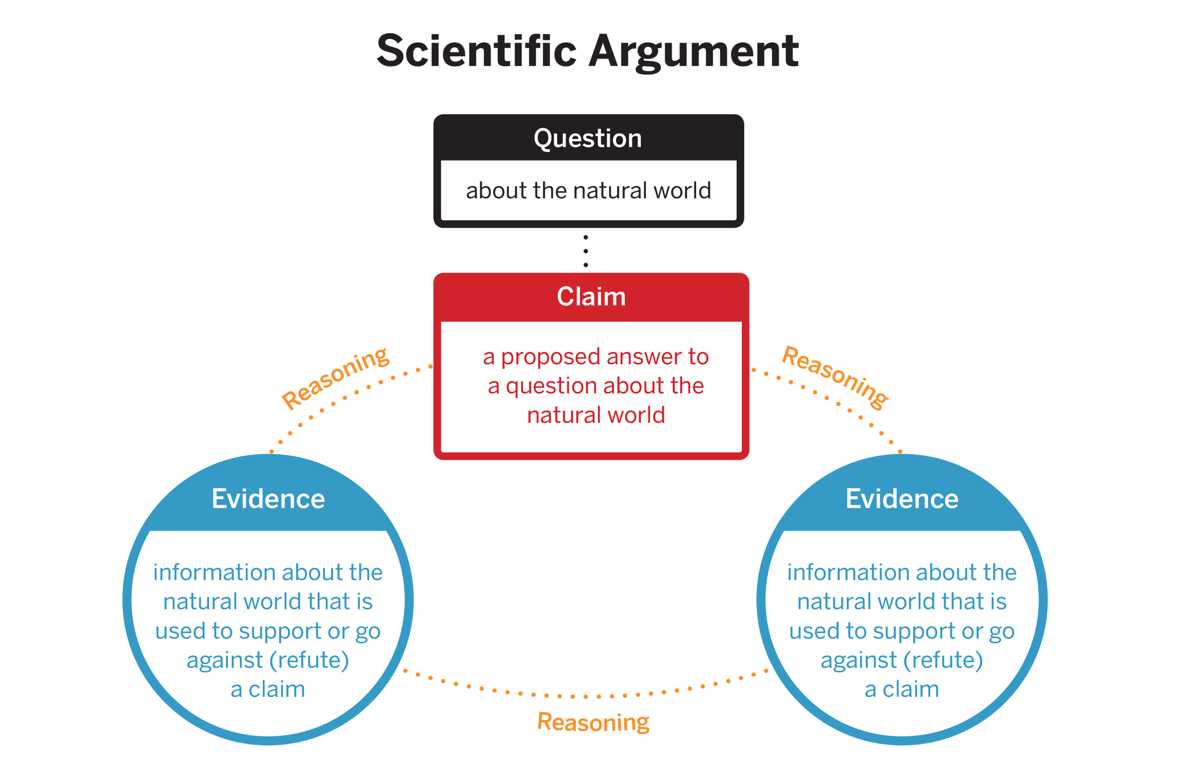
2.4.4 Teacher
Introducing the Homework
Now that you have a better understanding of natural selection, you will write Alex Young an argument for the claim you think is best supported about the mystery of the rough-skinned newts.
You will also read an article called “Invasion of the Periodical Cicadas.”
Reminder

Slide 28
2.4.4 Teacher
Introducing the Homework
Use the Reasoning Tool to write your scientific argument.
You have already done a lot of the preparation work for writing your arguments.
Start by stating your claim, which should be in last column of your Reasoning Tool.
Next, list your strongest piece of evidence from the first column.
After that, explain why this evidence matters by using what you wrote in the middle column.
Be sure to follow this process for each piece of evidence that you want to use to support your argument.

Slide 29
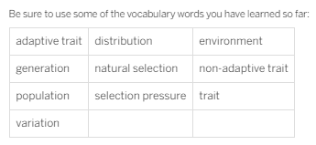
2.4.4 Homework
Write Scientific Argument
Write a scientific argument to Alex Young explaining why the newt population has become so much more poisonous in the past 50 generations.

Slide 30
Hidden SLIDE!
EXAMPLE Scientific Argument
Dear Alex Young,
This is how I think the rough-skinned newts in Oregon State Park become extremely poisonous:
Within the current and previous newt populations, there was variation among traits for amount of poison. Some individual newts had traits for no poison, some had traits for a low level of poison, some had traits for a moderate amount of poison, and some had the trait for a lot of poison. Over time, the newt population was able to become more poisonous because the initial population had at least some newts with high-poison levels.
Since predators (snakes) were present in the environment, the more poisonous traits were adaptive in the newt population. This is because a high level of poison helped the newts survive as the poison helped them avoid being eaten by the snakes. Over time, the newts with high-poison levels became more common in the newt population, and the newts with low-poison levels became less common. The population of newts couldn’t just become poisonous because they needed to. The high-poison levels became more common in the newt population because newts with higher levels of poison were more likely to survive longer than newts without them. Surviving longer means the newts had more chances to reproduce and pass their traits onto their offspring. Since offspring inherit their genes for their traits from their parents, newts have poison levels that are similar to their parents. So, because the newts with high-poison levels could survive longer and have more offspring, the more poisonous newts became more common in the population.

