Slide 1
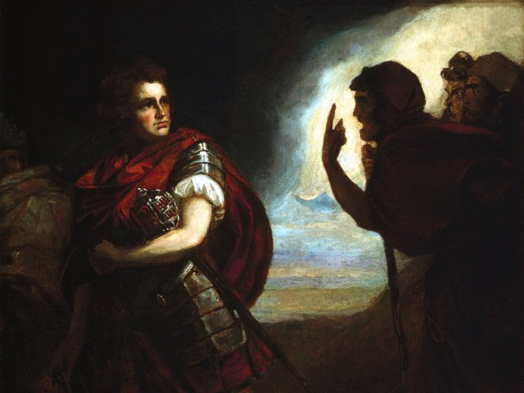
The Tragedy of Macbeth
Lesson 6

Slide 2
Activator-Comic Relief Handout

Slide 3
Activity 1- The Porter Scene

Slide 4
The Porter-Comic Relief

Slide 5
Activity 2- Enter Macduff

Slide 6
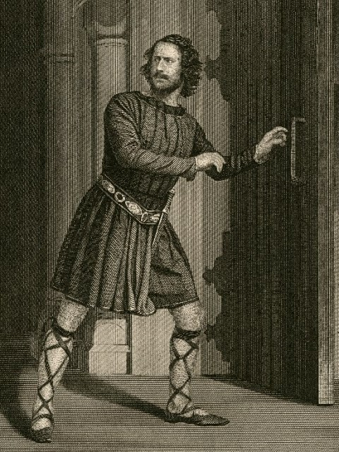
Enter Macduff
Macduff comes to get the king in the morning. Macduff is a thane and a very loyal man. He finds the king dead and is horrified by the event.

Slide 7
Text Dependent Questions (Graded)
What does Lennox report to Macbeth about the night before?
Macbeth murders the guards after he goes to see the king dead for himself. What reason does he give for murdering the guards and what is the probable real reason he murdered them?
How does Lady Macbeth draw attention away from Macbeth and does it work?
What do Malcom and Donalbain do after they hear the news of their father’s death?

Slide 8
Activity 3- Scene 4- The Old Man

Slide 9
Summary 2.3
The old man is used as a pawn to carry out the idea that the natural world has been upset. He tells Ross of strange things that go against nature that have happened the night before.
Macduff is also shown to be against Macbeth. After he gives the news that Macbeth has been named as king he reports that instead of going to his inauguration, a thing he should do as a thane, he will go home instead.

