Slide 1
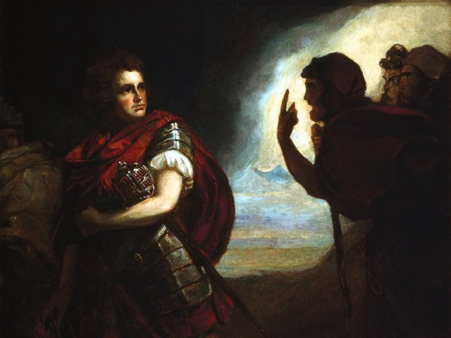
The Tragedy of Macbeth
Lesson 3

Slide 2
Activator- Foreshadowing

Slide 3
Foreshadowing
Authors use foreshadowing to create suspense, interest, and intrigue in their work. Read the following introduction to a short story and highlight five phrases that may be foreshadowing and then explain what you think it may foreshadow later in the story on the back of your worksheet. Be ready to present your ideas to the class.

Slide 4
Activity 1- Close Reading 1.4

Slide 5
1.4 Summary
Duncan hears the news of the Thane of Cawdor’s death and laments his trust of him.
Banquo and Macbeth (mostly Macbeth) are honored.
Duncan announces that his son Malcom will be Prince of Cumberland.
Duncan makes arrangements to travel to Inverness.

Slide 6
Activity 2- Foreshadowing in 1.4

Slide 7
Scavenger Hunt
Highlight at least three pieces of text that you feel are examples of foreshadowing in your copy of the play.

Slide 8
Activity 3- Macbeth’s Desires

Slide 9
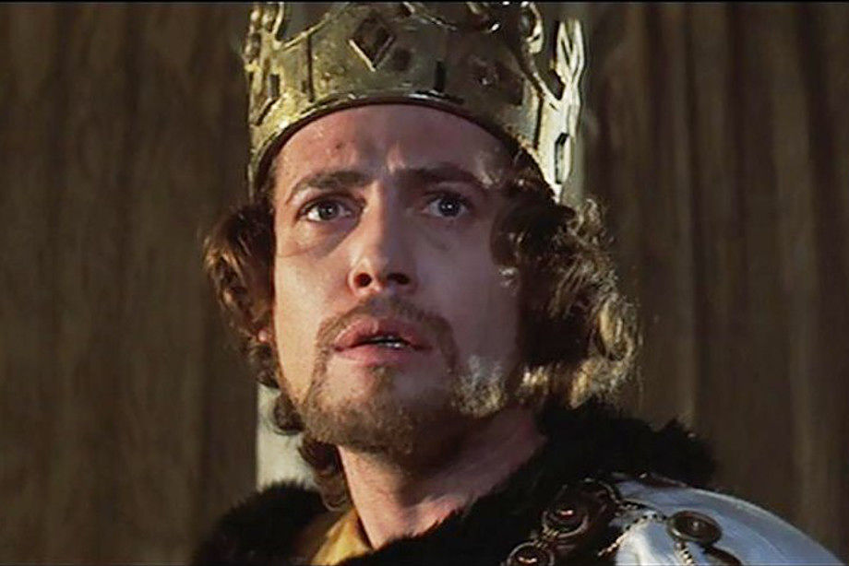
My Dark and Deep Desires
The Prince of Cumberland! That is a step
On which I must fall down or else o’erleap,
For in my way it lies. Stars, hide your fires;
Let not light see my black and deep desires.
The eye wink at the hand, yet let that be
Which the eye fears, when it is done, to see.
Based on this aside, what do you think Macbeth’s motives are at this point?

Slide 10
Activity 4- Spotlight on Lady Macbeth

Slide 12
What we know- #1
She thinks her husband is too weak to act upon what he claims he will do. She says that he is “too full of the milk of human kindness” which is an idiom for compassion and caring for others. Basically, she thinks he is too soft to do what needs to be done.

Slide 13
What we Know- #2
She asks the spirits to unsex her so that she can be as evil as a man. In this time period women were thought incapable of murder. It was believed that women were weak and could not do the things that men could do like fight in battles, hunt and kill animals, or kill another human. Furthermore, Lady Macbeth is a Christian and as one should not be asking spirits to unsex her. This would not have set well with Shakespeare’s audience; however, he knew exactly what he was doing. Women like Lady Macbeth were killed upon suspicion of witchcraft in his world.

Slide 14
What we Know- #3
She tells her husband to leave the plans of Duncan’s murder to her AND he listens to her. When Macbeth arrives at the castle she tells him that his face is an open book and that he must learn to look innocent while being a serpent underneath. This is an allusion to the biblical story of the Garden of Eden in which the devil disguises himself as a snake in order to trick Eve. Even more important is the fact that Macbeth, a man living in a world where women have no say and no power, allows his wife to run the show. This fact speaks volumes about both of these characters.

Slide 15
Activity 5- Close Reading 1.5

Slide 16
1.5 Summary
Lady Macbeth reads a letter from Macbeth telling her about the prophecies.
Macbeth arrives and tells her that the king will arrive that day.
Lady Macbeth asks Macbeth to allow her to plan the murder.

Slide 17
Activity 6- Class Discussion

Slide 18
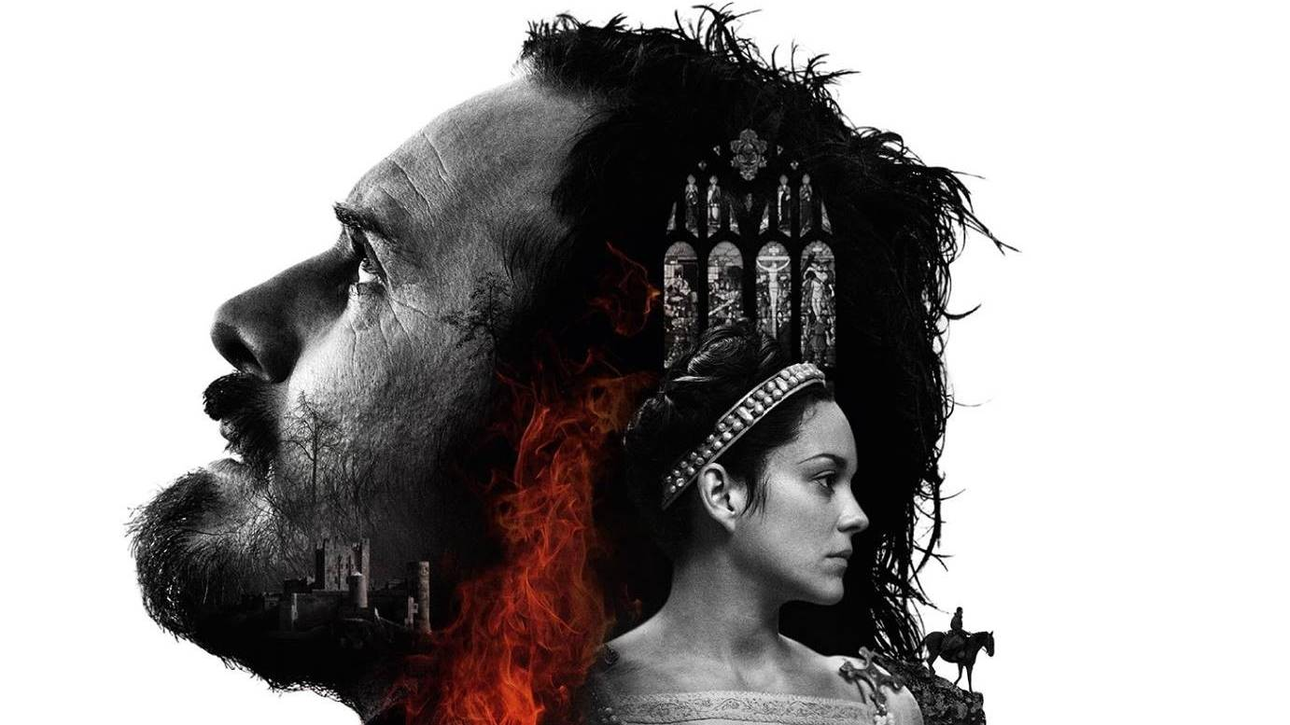
Class Discussion
How has Macbeth changed as a character so far in the play?

