Slide 1
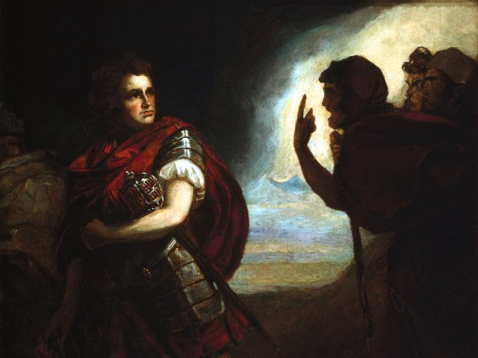
The Tragedy of Macbeth
Lesson 2

Slide 2
Activator- Who are you talking to?

Slide 3
Watch Me!
Watch this video and notice who Jimmy Fallon is talking to when he is looking at the camera.

Slide 4
Who is he talking to in this clip?
He is talking to YOU! This literary technique is called an aside. An aside is used in plays, commercials, television programs, and movies as a way for a character to talk directly to the audience. It is can be staged as the character is talking to himself or to you as the viewer. Plays usually stage asides as characters who are talking to themselves, but they are saying something that needs to be known by you, the audience.

Slide 5
Activity 1- What is the Purpose? Lines 1-38

Slide 6
Enter the Weird Sisters
The conversation the witches are having when the scene opens has NOTHING to do with the advancement of the play. Why would Shakespeare include this conversation?

Slide 7
Activity 2- The Prophesies Lines 39-93

Slide 8
I predict that you will………..
The witches tell Macbeth………
He is Thane of Glamis (He already knows that)
He is Thane of Cawdor (He thinks that the Thane of Cawdor is alive)
He will be king.
They tell Banquo…….
1. That he will not be king, but his son will be.

Slide 9
Putting it all Together……
Based on what you know about witches during this time period, how do you think the following people would feel about the prophesies?
Macbeth Banquo The Audience

Slide 10
Activity 3- True Lies? Lines 94-175

Slide 11
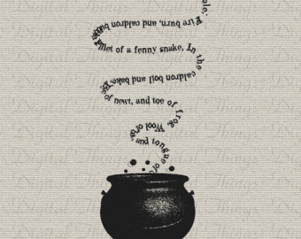
Borrowed Robes
Ross and Angus show up to tell Macbeth what we already know. Macbeth is stunned with the fulfillment of the first prophecy. His asides tell us what he is really thinking.

Slide 12
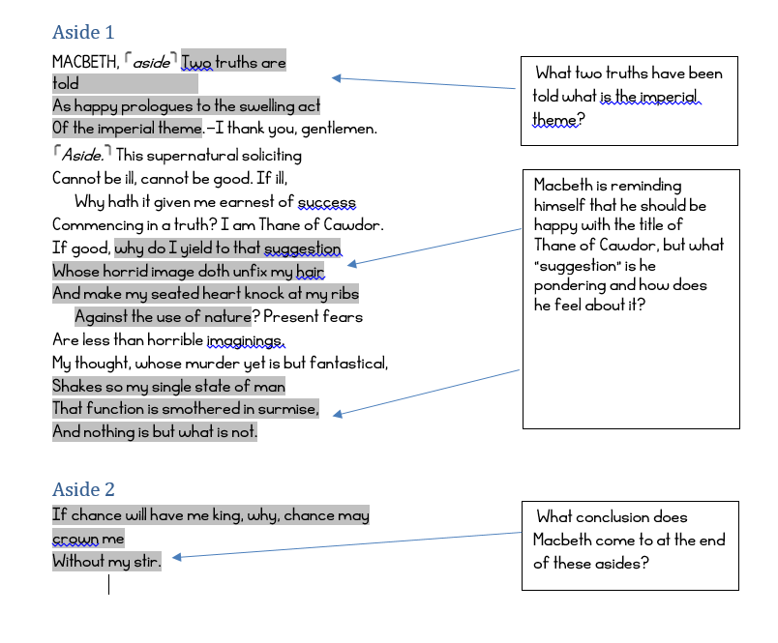
Analyze the following asides
and decide on what Macbeth’s
Intentions are at this point in the play.

Slide 13
Activity 4- Quick Write

Slide 14
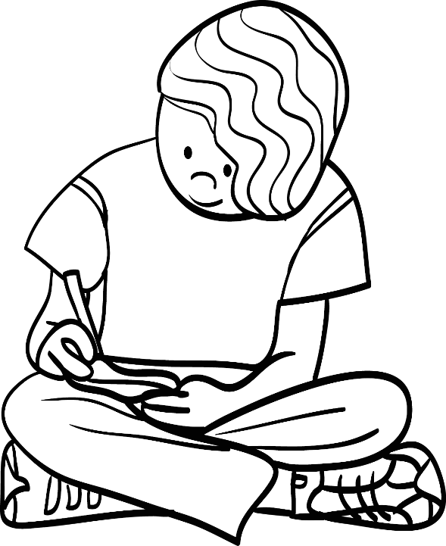
Prompt
What do these asides tell us about Macbeth’s thoughts and how he feels about them?

