Slide 1
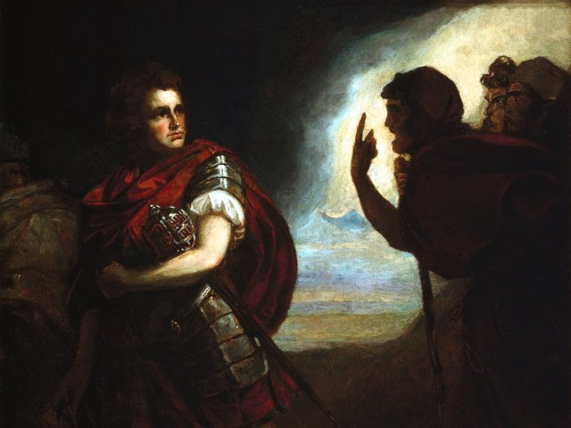
The Tragedy of Macbeth
Lesson 8- Act 3, Scenes 4-6

Slide 2
Activator- Shakespeare’s Ghosts

Slide 3
Ghosts In Shakespeare's Time

Slide 4
Activity 1- Close Reading of 3.4

Slide 5
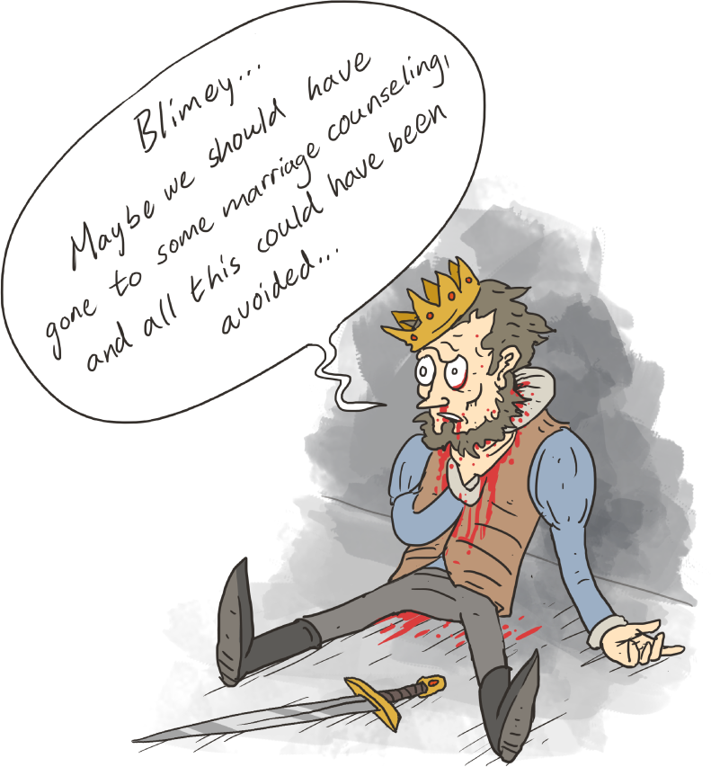
Graded Class Discussion
Graded Class Discussion: How has becoming a murderer changed Macbeth as a person? You will brainstorm with a group and then share your thoughts in small discussion groups. You will get twenty points for every piece of information added to the discussion. No duplication of information is allowed.

Slide 6
Activity 2- Close Reading of 3.5 Hecate is ANGRY

Slide 7
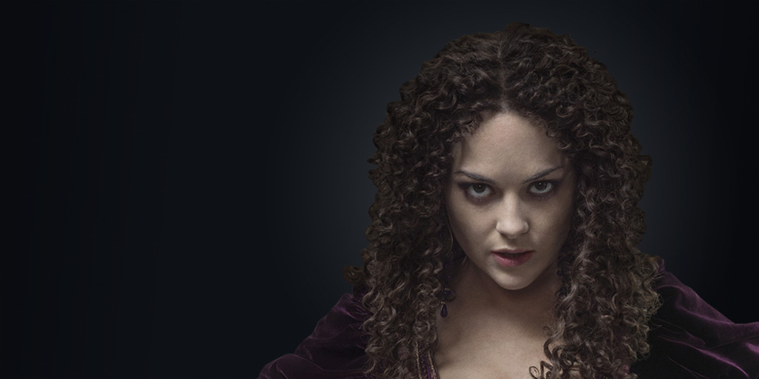
Annotation Skills
Using Hecate’s speech, annotate the reasons she is angry and place your thoughts beside the text.

Slide 8
Activity 3- What is the Purpose? 3.6

Slide 9
What is the Purpose?
After reading 3.6 determine what purpose the scene has for the reader.

