Slide 1
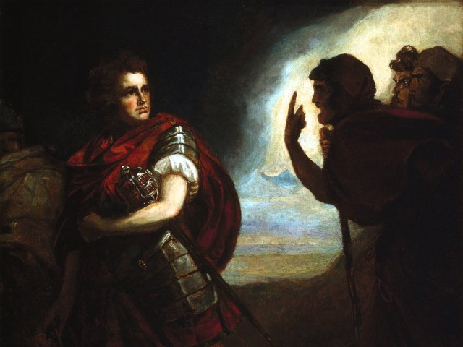
The Tragedy of Macbeth
Lesson 5

Slide 2
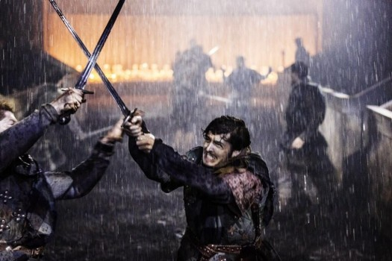
Activator-
Two can keep a secret if one is dead.

Slide 3
Consider Banquo
Brainstorm:
What does Banquo know?
How could he hurt Macbeth?
Why would he want to hurt Macbeth?
Why would Macbeth want to keep him safe?
Why would Macbeth want to dispose of him?
You will present one of these to the class!

Slide 4
Activity 1-
Close Reading of 2.1

Slide 5
Testing the Waters
Macbeth is new to the world of treachery. Banquo is his best friend in the entire world. He does not want to have to hurt him; however he does stand in his way. Macbeth tests the waters in 2.1 and finds some distressful information.
MACBETH
If you shall cleave to my consent, when ’tis,
It shall make honor for you.
BANQUO
So I lose none
In seeking to augment it, but still keep
My bosom franchised and allegiance clear,
I shall be counseled.
If you will ally yourself with me when it is time I will give you great honors.
Sure, as long as I do not have to risk my own honor and conscience.

Slide 6
Metaphors for Understanding
We are about to watch two movie clips from the 1999 movie “Lake Placid.” In this movie a giant alligator terrorizes the town and must be destroyed. The alligator will serve as a metaphor for the king in this play. Macbeth must kill him in order to achieve what he wants. In the second clip, the baby alligators will serve as a metaphor for Banquo. Watch both clips and then we will discuss what Banquo represents for Macbeth.

Slide 7
Clip 1
Feeding the Enemy

Slide 8
Clip 2
Feeding the New Enemy

Slide 9
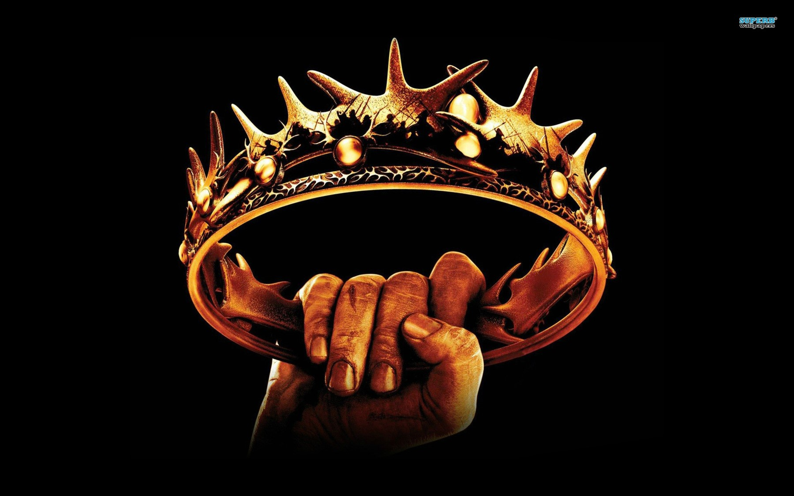
Extending the Metaphor
Discussion:
How is Banquo like the baby alligators?

Slide 10
Activity 2-
Is this a Dagger?

Slide 11
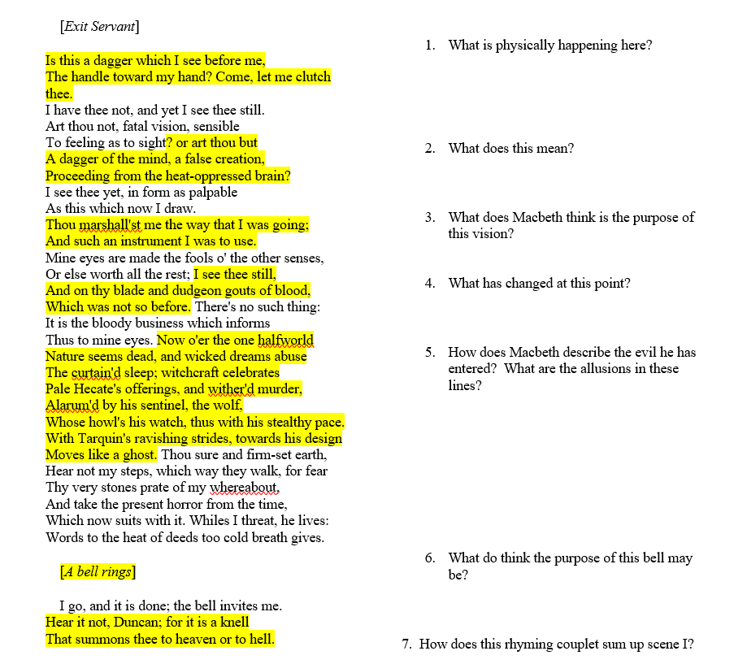
In groups of three or four you will deconstruct Macbeth’s famous speech and answer the questions on the side of the worksheet.

Slide 12
Activity 3-
Video 2.2
Performance

Slide 13
Act 2. Scene 2 Video

Slide 14
Activity 4-
Close Reading of 2.2

Slide 15
Notice…
Lady Macbeth’s scattered speech
Lady Macbeth’s hidden fear
Macbeth’s reaction to the deed
Macbeth’s imagined voices and inability to pray
Macbeth’s in ability to frame the guards

Slide 16
Activity 5-Scavenger Hunt

Slide 17
Groups
Lady Macbeth Group | Macbeth Group
Prove that Lady Macbeth is nervous, but also believes that they must go on with the original plan and put the murders behind them. | Prove that Macbeth has regrets about killing the king and that he is afraid of the consequences of his actions.

Slide 18
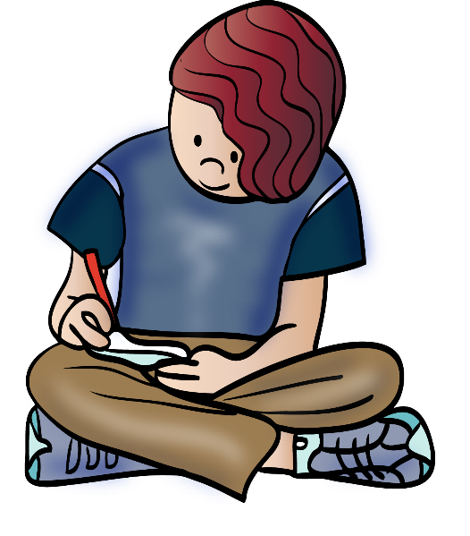
Prepare for a Writing Quiz
Tomorrow you will use your notes to prove in writing the statement that you proved with your direct quotes in today’s lesson.

