Slide 1
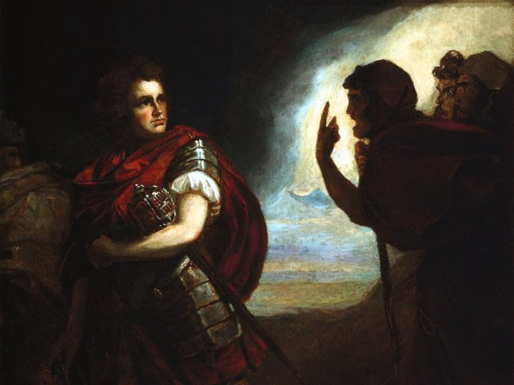
The Tragedy of Macbeth
Lesson 13- Act 5, Scenes 6-8

Slide 2
Activator- The Tragic Hero

Slide 3
The Tragic Hero According to Aristotle
1) Flaw or error of judgment
2) A reversal of fortune brought about because of the hero's error in judgment.
3) The discovery or recognition that the reversal was brought about by the hero's own actions.
4) Excessive Pride (hubris)
5) The character's fate must be greater than deserved.

Slide 4
What Could Macbeth’s Tragic Flaw be?

Slide 5
What Could Macbeth’s Fatal Error have been?

Slide 6
Activity 1- Close Reading of 5.6

Slide 7
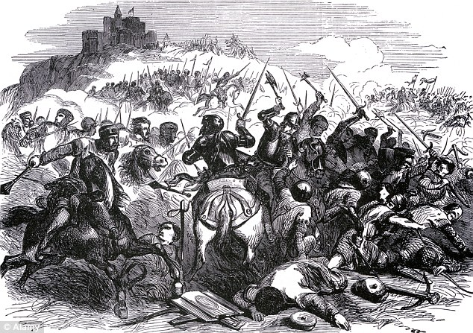
What happens when Macbeth’s Castle was Attacked?

Slide 8
Activity 2- Close Reading of 5.7-5.8

Slide 9
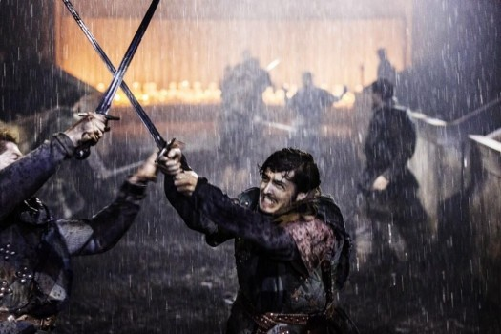

Slide 10
Activity 3- Close Read and Group Work

Slide 11
Group 1
What is a Roman Fool (see footnote) and why won’t Macbeth be one at this time? (lines 1–2)?
To whom or what does young Siward compare Macbeth (lines 7–11)?
Which prophecy still has not been proven false for Macbeth?

Slide 12
Group 2
For whom is Macduff searching (lines 18-20)? Why is he searching for this character?
How does Shakespeare develop Macduff in lines 18–27?
What does the audience learn about the progress of the battle in lines 29–36?

Slide 13
Group 3
How do we know that Macbeth feels remorse for what he has done? Cite textual evidence.
What does Macduff reveal (lines 17–20)? What does this mean for Macbeth?
How does Macbeth feel about the witches now that the prophecies have been proven false?
What does Macbeth say the Witches have done to him (line 24)?
How does Macbeth’s response to Macduff’s revelation develop him as a tragic hero?

Slide 14
Group 4
How did Young Siward die and how did it prove that he was brave?
Compare the ways in which other characters describe Macbeth in Act 1.2 and Act 5.8. What adjectives are used to describe him in both scenes?
How does Shakespeare develop Macbeth as a tragic hero in this scene? Which aspects does he prove in this scene?
Who is king at the end of the play?

Slide 15
Activity 3- Quick Write

Slide 16
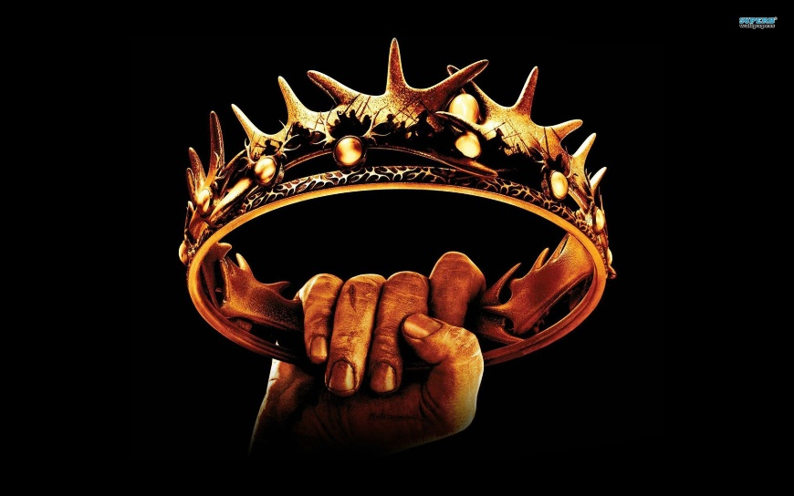
Quick Write
In a well-developed paragraph, explain how Macbeth was a tragic hero. Go over each characteristic of a tragic hero and how Macbeth fits each characteristic.

