Slide 1
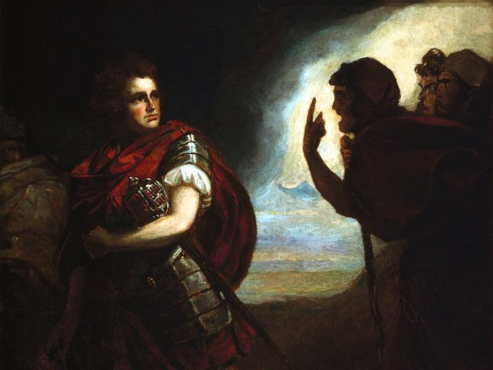
The Tragedy of Macbeth
Lesson 12- Act 5, Scenes 4-5

Slide 2
Activator- We Wear the Mask

Slide 3
We Wear the Mask
We wear the mask that grins and lies, It hides our cheeks and shades our eyes,— This debt we pay to human guile; With torn and bleeding hearts we smile, And mouth with myriad subtleties.
Why should the world be over-wise, In counting all our tears and sighs? Nay, let them only see us, while We wear the mask.
We smile, but, O great Christ, our cries To thee from tortured souls arise. We sing, but oh the clay is vile Beneath our feet, and long the mile; But let the world dream otherwise, We wear the mask!
Analysis
The author uses masks as a metaphor for the way we hide our true feelings and thoughts.
What does the first stanza say about why we wear these masks?
What type of mask does the author say should be shown to others?
What sort of emotion is beneath the masks?
Discussion: Who in “Macbeth” is wearing a mask and what is beneath it?

Slide 4
Activity 1- Close Reading of 5.4

Slide 5
When the Bough Breaks
Definition: Bough (n.)- A main branch of a tree
Critical Thinking: What will it look like when each of the 10,000 men take a bough and walk with it towards Macbeth’s castle?

Slide 6
Activity 2- Close Reading of 5.5 Tomorrow, Tomorrow, Tomorrow

Slide 7
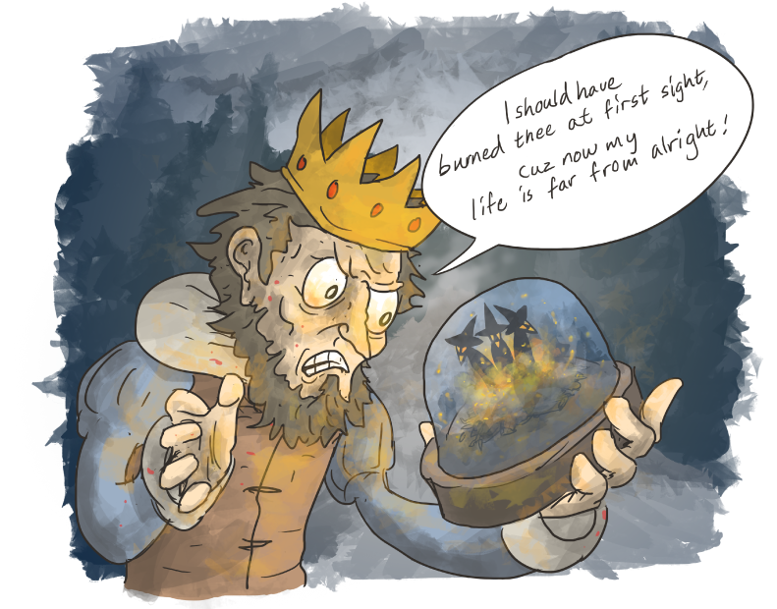
Tomorrow, Tomorrow, Tomorrow
Discussion: In what ways is Macbeth’s reaction to Lady Macbeth’s death different from his reaction to Duncan’s murder?

Slide 8
Activity 3- Quick Write

Slide 9
Quick Write
Based on the speech below, how does Macbeth feel about life? Use evidence from the speech to support your answer.
She should have died hereafter; There would have been a time for such a word. To-morrow, and to-morrow, and to-morrow, Creeps in this petty pace from day to day To the last syllable of recorded time, And all our yesterdays have lighted fools The way to dusty death. Out, out, brief candle! Life's but a walking shadow, a poor player That struts and frets his hour upon the stage And then is heard no more: it is a tale Told by an idiot, full of sound and fury, Signifying nothing.
Notice that Macbeth compares life to FOUR things in this speech: a candle, a walking shadow, a player(actor), and a tale(story).

