Slide 1
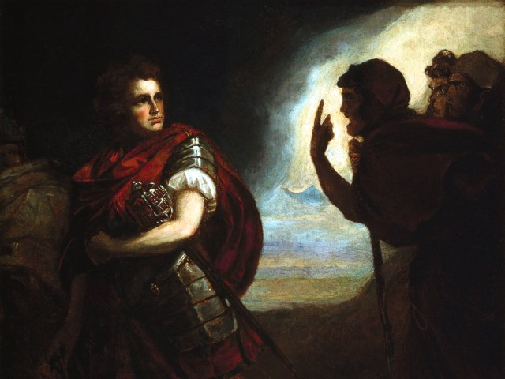
The Tragedy of Macbeth
Lesson 11- Act 5, Scenes 1-3

Slide 2
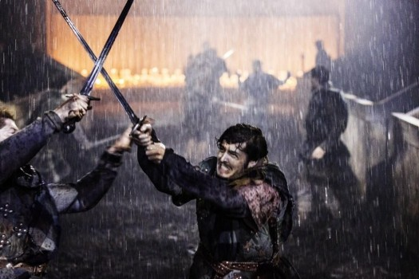
Activator-
Out, damned spot!

Slide 3
Lady Macbeth Video

Slide 4
Activity 1-
Close Reading of 5.1

Slide 5
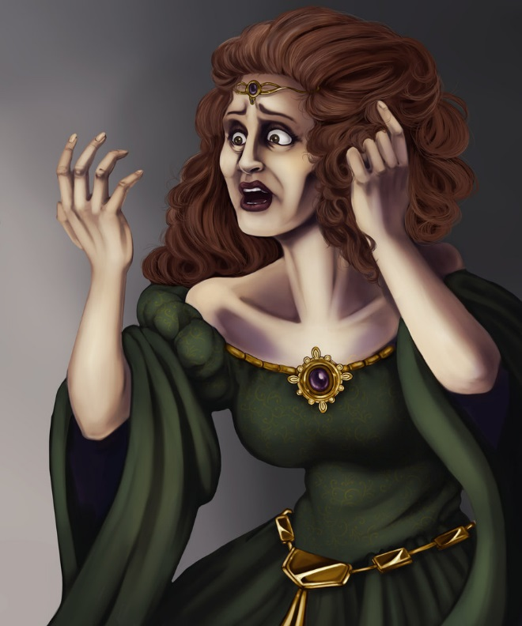
Text Dependent Question
How has Lady Macbeth changed since we saw her last? What could be the catalyst that sped up her transition into a remorseful character?

Slide 6
How are these quotes related?
Out, Damned Spot | A little water clears us of this deed.

Slide 7
Activity 2-
What is the Purpose?

Slide 8

What is the purpose of 5.2?
What does it tell us about Scotland?

Slide 9
Activity 3-
Macbeth’s Desires
5.3

Slide 10
Macbeth’s Desires
When we encounter Macbeth in 5.3 he is frantic and not himself. He hears news of the approaching army and his wife’s mental problems but brushes his problems aside and quotes the prophecy that says that he will not be defeated until the forest comes to fight against him. However, he tells the doctor what he truly desires. What is it?

Slide 11
Macbeth’s Speech
Come, put mine armour on; give me my staff.
Seyton, send out. Doctor, the thanes fly from me.
Come, sir, dispatch. If thou couldst, doctor, cast
The water of my land, find her disease,
And purge it to a sound and pristine health,
I would applaud thee to the very echo,
That should applaud again.--Pull't off, I say.--
What rhubarb, cyme, or what purgative drug,
Would scour these English hence? Hear'st thou of them?

