Slide 1
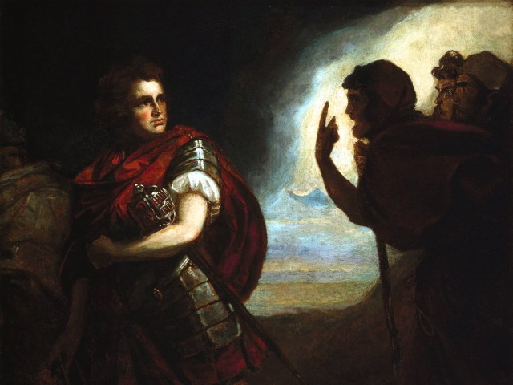
The Tragedy of Macbeth
Lesson 10- Act 4 Scene 3

Slide 2
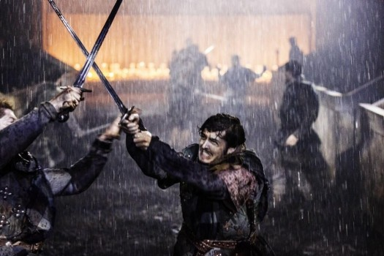
Activator-
Found Poetry Project

Slide 3
Assignment
You will create a Found Poem for Macbeth by proving one of the following ideas with nothing more than quotes from the play. A Found Poem is a poem made by using quotes and only quotes from a work of fiction to capture the essence of the work or idea. You will get thirty minutes in class today and ten minutes each day until the poem is due. You will receive fifteen bonus points to add to any assignment by reading your found poem to the class.

Slide 4
Ideas
Macbeth’s desire to be king
Macbeth’s weaknesses
Macbeth’s plight into darkness/evil
Lady Macbeth’s evil nature
The Witches’ cruelty/cunning nature
Banquo’s internal struggle with the prophecies and Macbeth
Suspicion of Macbeth by all of the other characters
Praise of Macbeth by all of the other characters
Your own idea:____________________________________________

Slide 5
Guidelines
You can use any format you want as long as you have at least twenty lines
All words must be direct quotes
You may break quotes apart
You may use quotes form a variety of characters
You may rhyme, but it is not mandatory
You do not have to use quotes in the order they appear in the play

Slide 6
Suggestions
Create a format and stick with it (# of lines in a stanza)
Vary the length of your lines
Create a story with your quotes
Make many drafts!
Get feedback (from me, peers, parents, other teachers)
Hand in a draft.

Slide 7
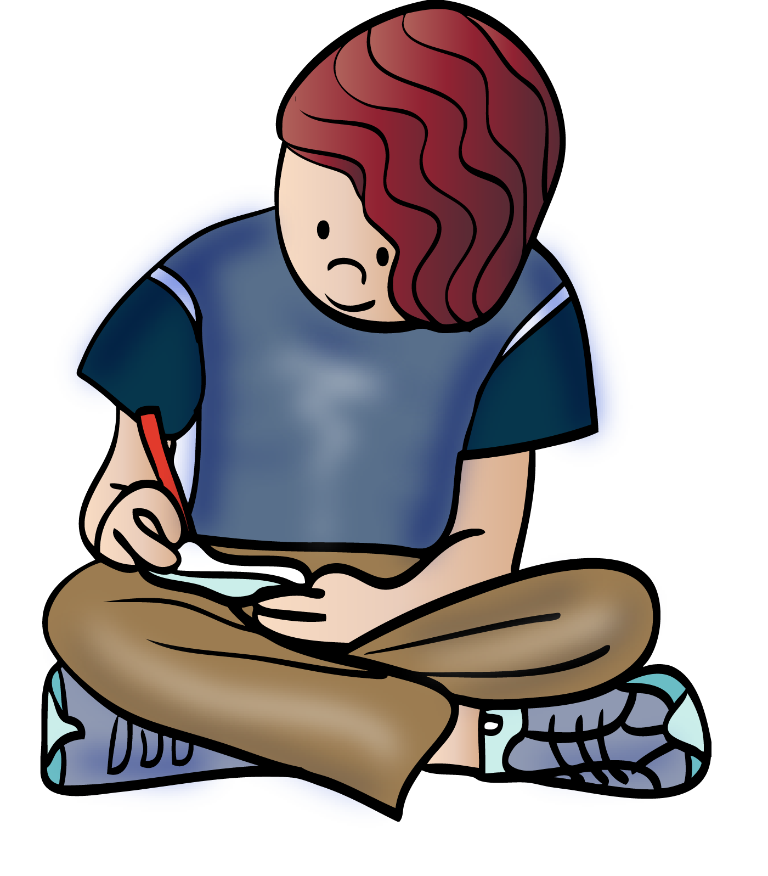
Work Time…

Slide 8
Activity 1-
Close Reading of 3.3

Slide 9
Vices and Virtues
A virtue is a habit or an acquired human quality of character that allow one to achieve personal happiness. By definition, then, virtue is something good, an "excellence" of human character. There cannot be a bad virtue. Vice is the opposite—a habit that spoils one's chances of achieving personal happiness.

Slide 10
Vices..

Slide 11
Virtues……

Slide 12
Discussion:
Why does Malcom try to trick Macduff?
How do we know Macduff is a loyal citizen of Scotland?

