Slide 2
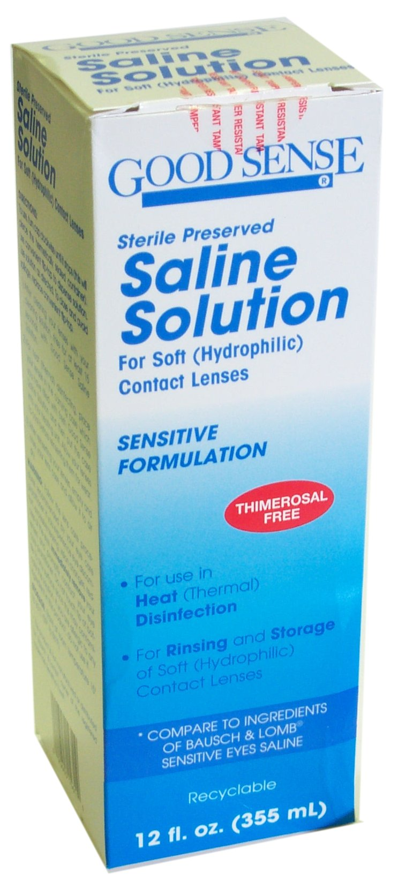
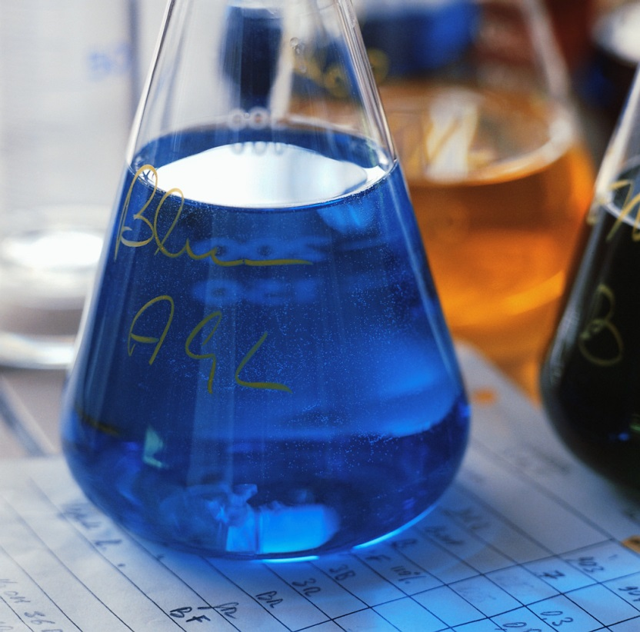
Homogeneous – has uniform composition throughout sample. EX: Saltwater, air, rum.
Homogeneous mixtures are also called solutions.

Slide 3
Solutions consist of:
a) a solute – the substance that is dissolved EX: the salt in salt water
b) a solvent – the substance that does the dissolving EX: the water in salt water

Slide 4
Properties of Solutions
Has been well stirred during its formation.
Dissolved particles will not come out of solution no matter how long the solution is allowed to stand.
Is clear and transparent. Beam of light will not be seen
Will pass through the finest filters
http://www.youtube.com/watch?v=EAhn2TUPL4w

Slide 5
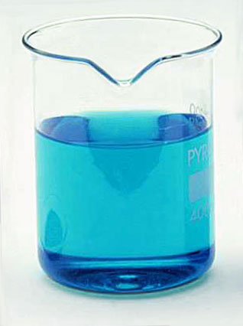
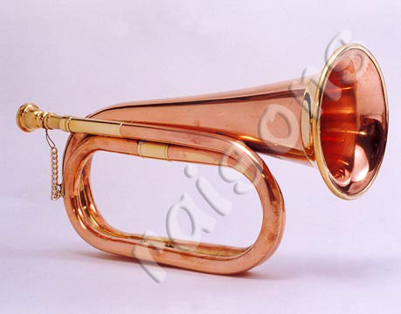
Solutions can be found in any physical state.

Slide 6
Types of Solutions
Phase
Solute
Solvent
Example
Gas
gas
gas
air
Liquid
gas
liquid
Coke
Liquid
liquid
liquid
antifreeze
Liquid
solid
liquid
Coke
Solid
gas
solid
H₂ in Pt
Solid
solid
solid
alloys

Slide 7
Solubility
Solubility – maximum quantity of a solute that can dissolve in a certain quantity of solvent at a specified temperature
Ex: Think of sugar in iced tea

Slide 8
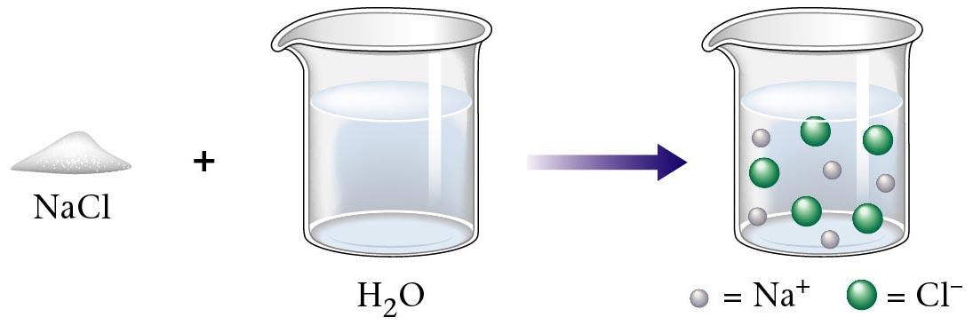
Dissolving of solid sodium chloride.

Slide 9
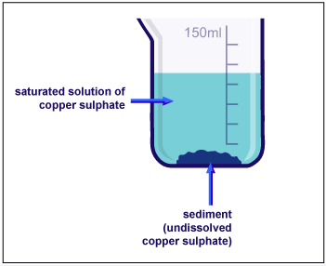

Slide 10
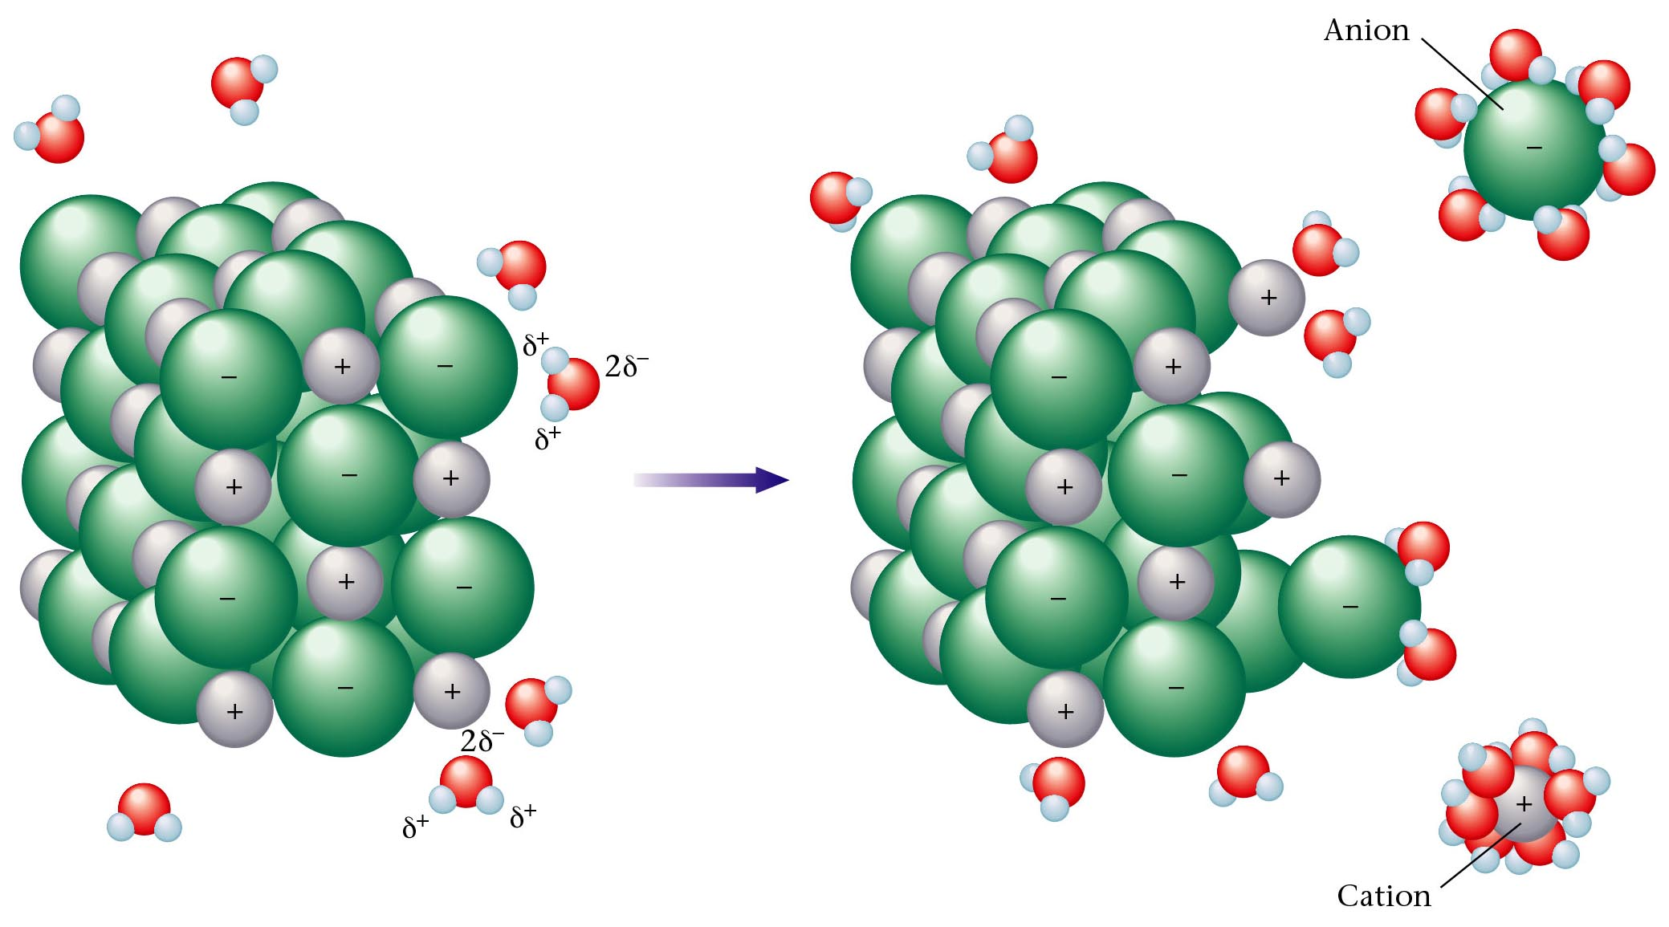
Polar water molecules interacting with positive and negative ions of a salt.

Slide 11
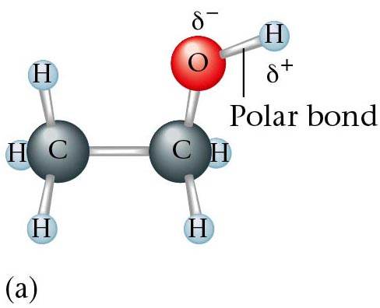
The ethanol molecule contains a polar O—H bond.

Slide 12
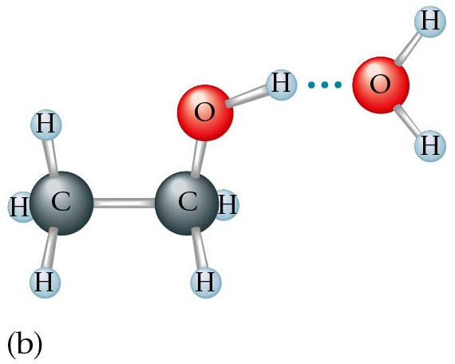
The polar water molecule interacts strongly with the polar O—H bond in ethanol.

Slide 13
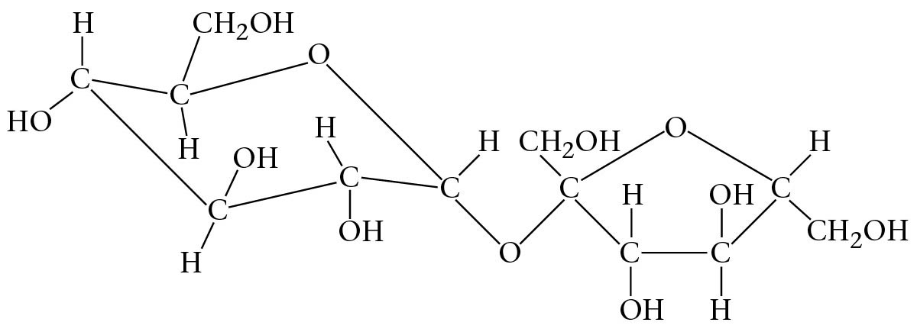
Structure of common table sugar.

Slide 14
A molecule typical of those found in petroleum.

Slide 15
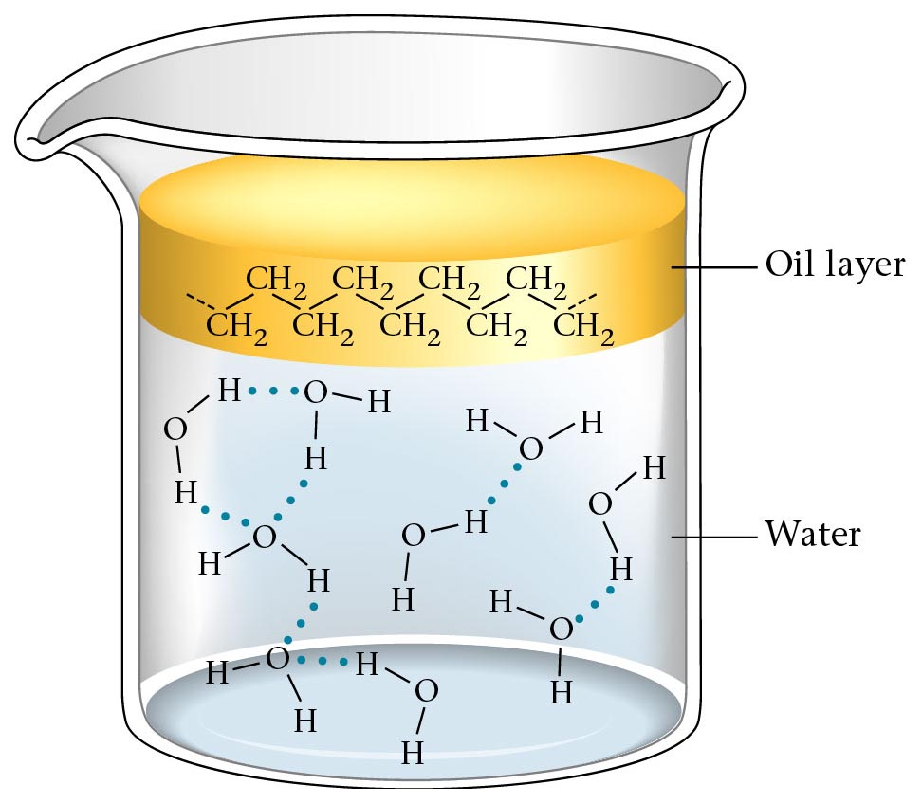
An oil layer floating on water.

Slide 16
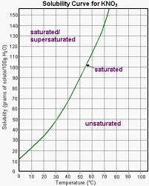
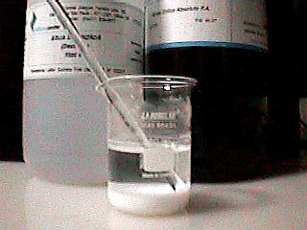

Slide 17
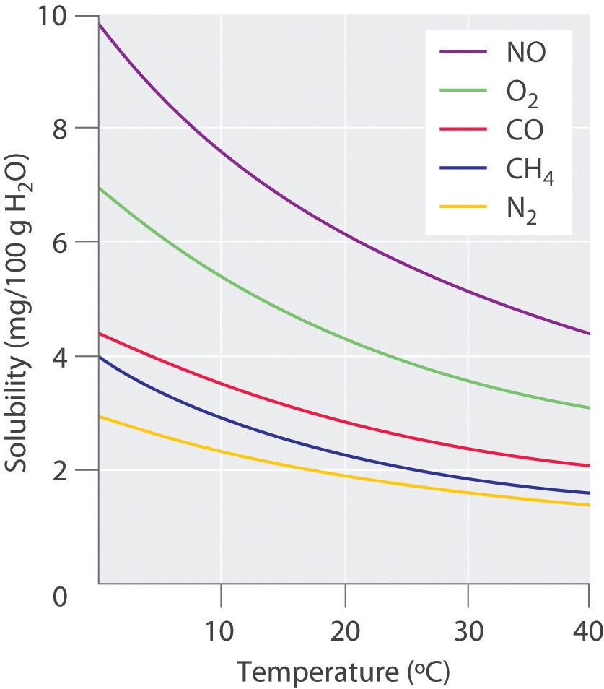

Slide 18
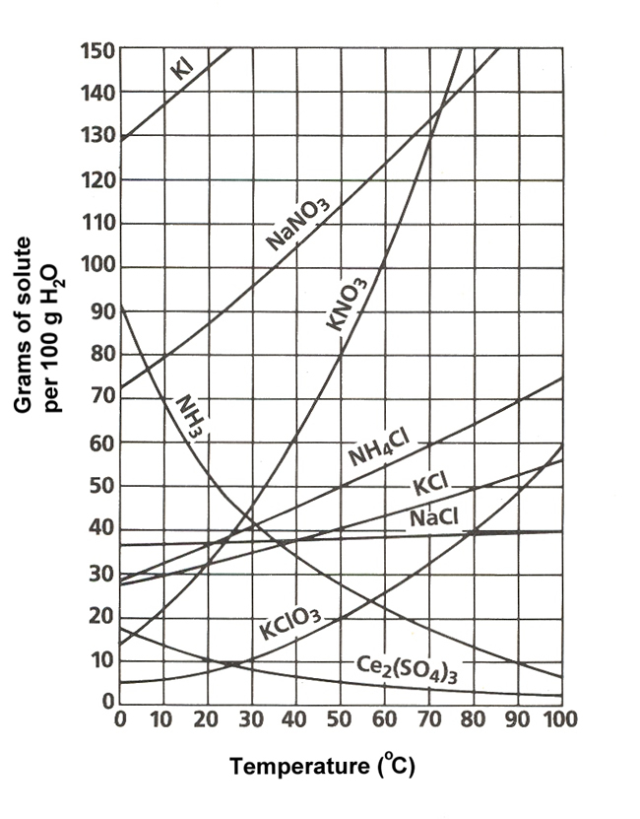

Slide 19
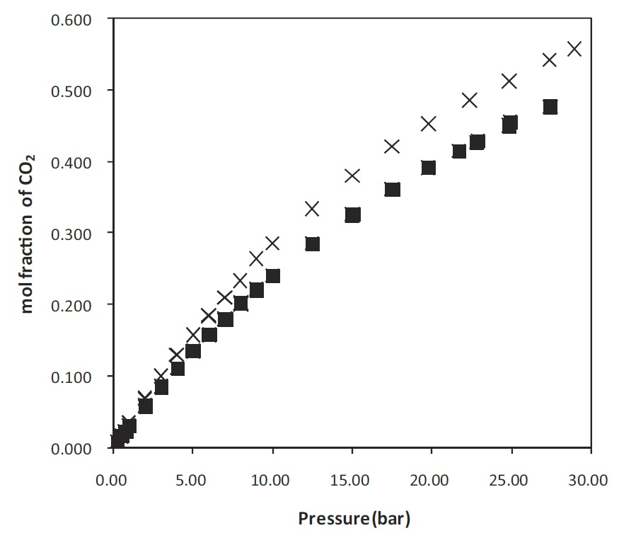

Slide 20
Saturated, Unsaturated and Supersaturated
Unsaturated – solvent can still dissolve more solute at a given temperature
Saturated – solvent can not dissolve any more solute at a given temperature

Slide 23
Supersaturated – When a solution has more dissolved solute than it can normally hold. You can only get a supersaturated solution by cooling a saturated solution.
https://www.youtube.com/watch?v=mxO9rtVjoR4

Slide 24
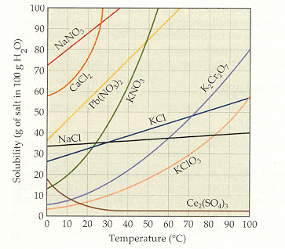

Slide 25
Concentration of Solutions
Units
Symbol
Definition
Mass percent
% m/m
(m_{solute}/m_{solution} ) x100
Volume percent
% v/v
(v_{solute}/v_{solution} ) x100
Mass/volume percent
% m/v
(m_{solute}/v_{solution} ) x100
Parts per million
ppm
mg_{solute}/L_{solution}
Parts per billion
ppb
µg_{solute}/L_{solution}
Molarity
M
mol_{solute}/L_{solution}
Molality
m
mol_{solute}/kg_{solvent}

Slide 26
Molarity
moles solute
Liter solution
mol
L
[solute] =
M =
=
What volume of a 0.035 M AgNO₃ solution can be made from 5.0 g AgNO₃ ?
1 mole AgNO₃
L
5.0 g AgNO₃
x
x
=
0.840 L
169.91g
0.035 mole AgNO₃

Slide 27
1. How many grams of NaCl do you need to make 250. mL of 0.125 M NaCl_{(aq)}?
2. What is the molarity of a 725 mL aqueous solution that contains 2.50 mol of NaOH?
3. How many moles of LiCl are in 250. mL of 3.00 M LiCl

Slide 28
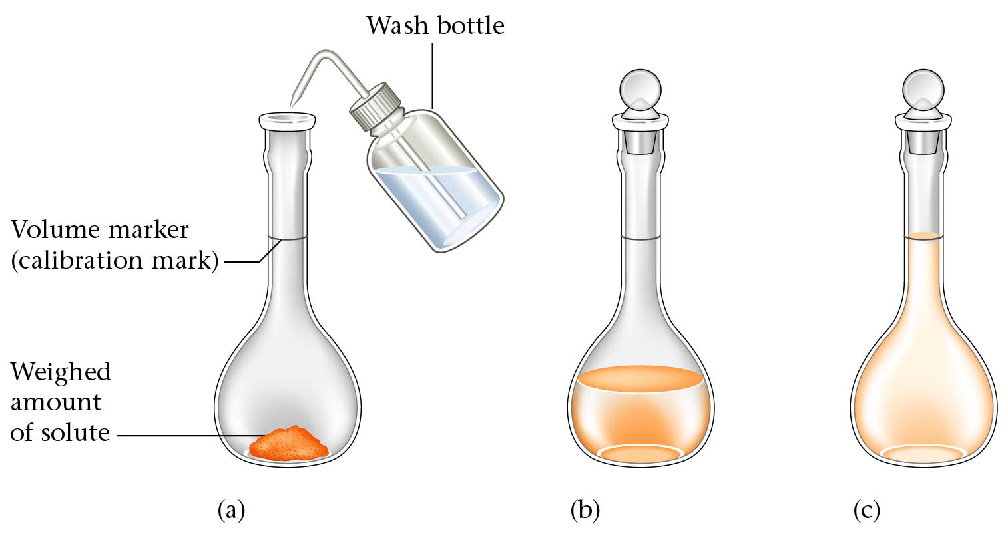
Steps involved in the preparation of a standard aqueous solution.

Slide 29
Dilution Problems
(Molarity of concentrate)(Volume of concentrate)= (Molarity of dilute)(volume of dilute)
M_{c}V_{c}=M_{d}V_{d}
Usually you will solve for V_{c} :
the amount of concentrated solution needed to
make a certain amount of more dilute solution.

Slide 30
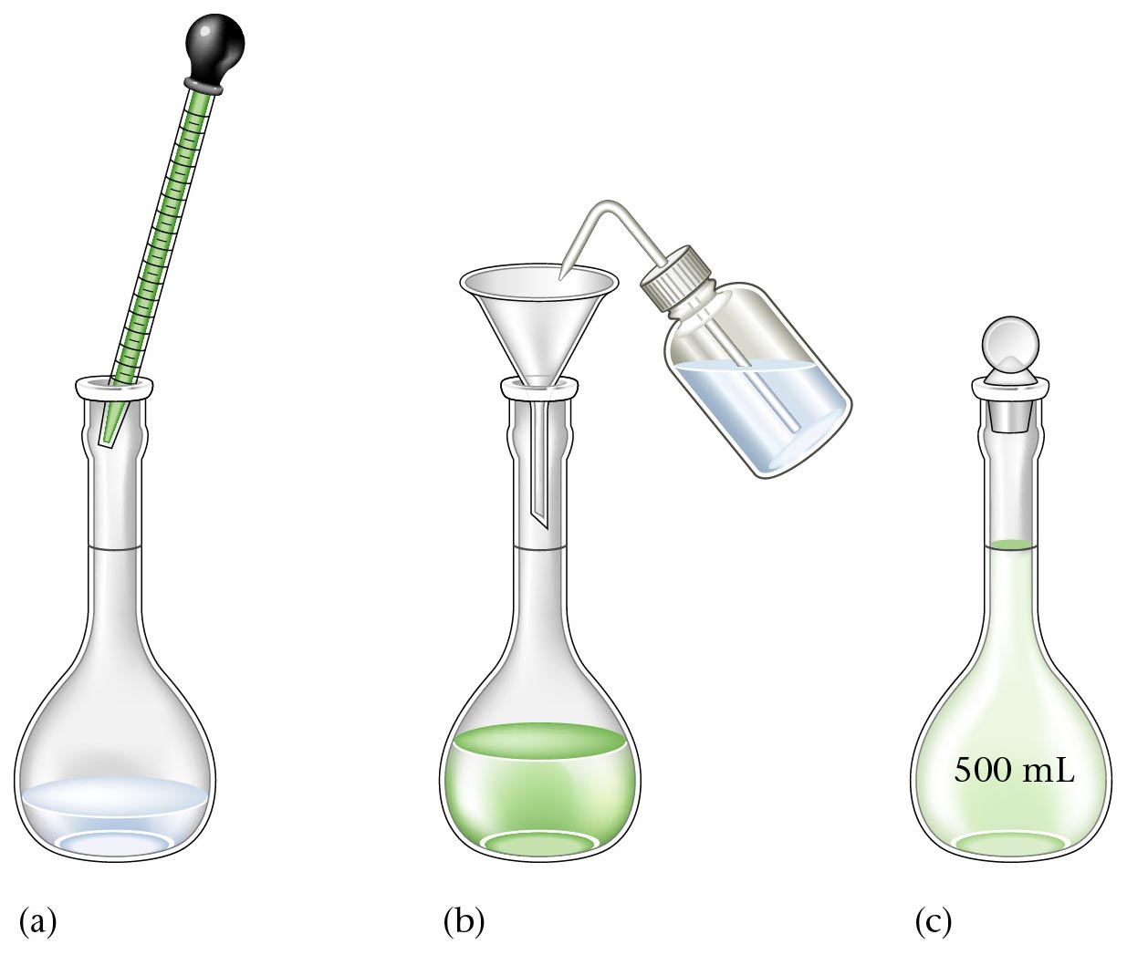
Process of making 500 mL of a 1.00 M acetic acid solution.

Slide 31
What volume of 12.0 M HNO₃(aq) is needed to make
225 mL of 1.00 M HNO₃(aq)?

Slide 32
Suppose you have two substances, “A” and “B”, in a rxn.
The following flow chart shows the stoichiometric relationship
between them:
GIVEN
VOLUME OF “A” (L)
GIVEN
MOLES OF “A”
MOLES OF “B” SOUGHT
GRAMS OF “B”
SOUGHT
(mass)
mol A .
X 1 L (molarity)
molar mass
X of B
1 mol B
coefficient of sought (B)
X coefficient of given (A)

Slide 33
For the rxn: FeCl_{2(aq)} + 2 NaOH_{(aq)} → Fe(OH)_{2(s)} + 2 NaCl_{(aq)}
1. How many grams of Fe(OH)_{2(s)} can be produced from 125 mL of 3.00 M NaOH_{(aq)}?
2. How many grams of of Fe(OH)₂ can be made from 25 mL of 2.5 M FeCl₂?

Slide 34
Molality (m)
moles solute
kg solvent
mol
kg
m =

Slide 35
1. What is the molality of a solution that contains 16.3 g of potassium chloride dissolved in 845 g of water? (.258m)
2. What is the molality of the solution formed by mixing 104 g of silver nitrate with 1.75 kg of water? (.350m)

Slide 36
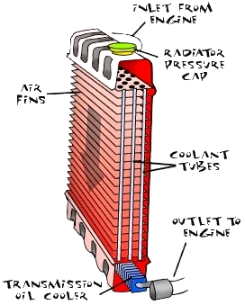
Colligative Properties – properties of solutions that depend only on the concentration of dissolved particles, not the type of dissolved particle.
1. Boiling Point Elevation – dissolved substances raise the boiling point of the solvent.
2. Freezing Point Depression - dissolved substances lower the freezing point of the solvent.

Slide 37
Non-solution Mixtures (Heterogeneous Mixtures)
Suspension – a mixture that separates if allowed to settle. EX: oil & vinegar; mud; paint
Colloid – a stable heterogeneous mixture. Colloids do not separate. Usually appear cloudy or milky. EX: milk; mayonnaise; jelly; jels and foams

Slide 38
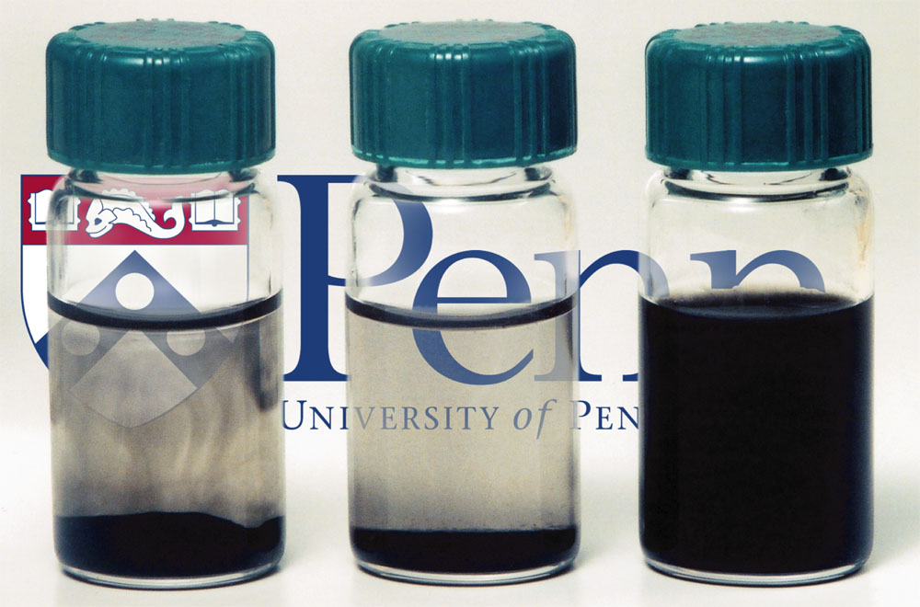

Slide 39
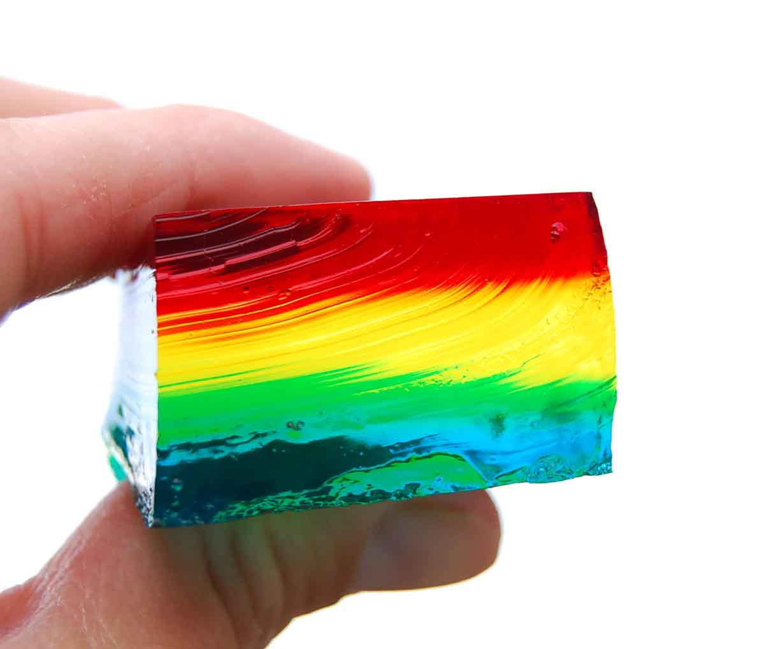

Slide 40
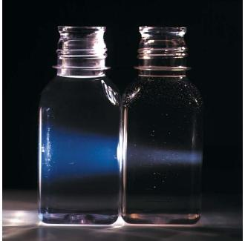

Slide 41
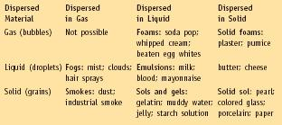

Slide 43
Saturated Solution | A solution with solute that dissolves until it is unable to dissolve anymore, leaving the undissolved substances at the bottom.
Unsaturated Solution | A solution (with less solute than the saturated solution) that completely dissolves, leaving no remaining substances.
Supersaturated Solution | A solution (with more solute than the saturated solution) that contains more undissolved solute than the saturated solution normally holds. Can only be made by cooling a saturated solution.

Slide 44
