Slide 1
Chemical Kinetics
and Chemical Equilibrium
Honors: Ch. 17 and 18
Read in Ch. 22: Reaction Rates pp 543-554
Equilibrium pp 560-566

Slide 2
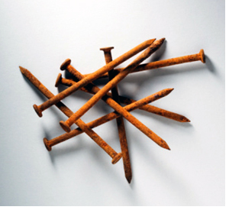
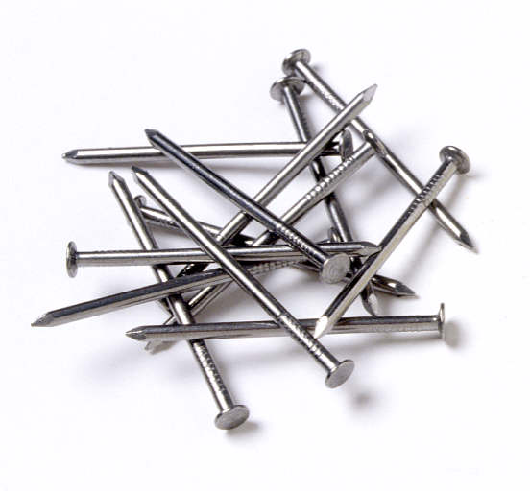
Chemical Kinetics
Reaction Rates

Slide 3
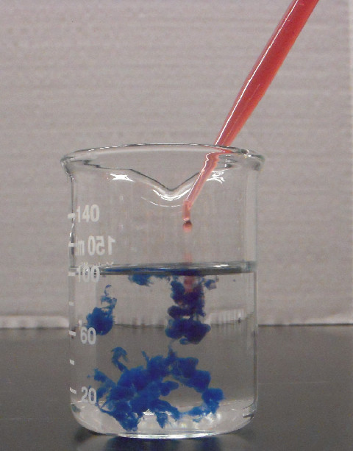
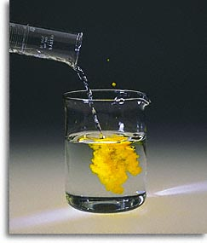

Slide 4
Reaction Rates: Basic Concepts
Collision Theory
According to the collision theory, atoms, ions, and molecules must collide with each other in order to react.
The following three statements summarize the collision theory.
1. Particles must collide in order to react.
2. The particles must collide with the correct
orientation.

Slide 5
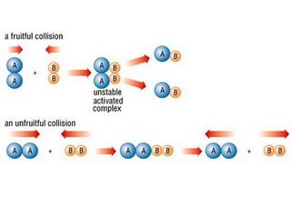
Collision Orientation Animation

Slide 6
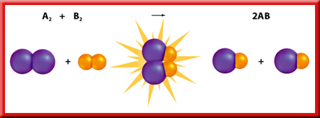
Reaction Rates: Basic Concepts
3. The particles must collide with enough
energy to form an unstable activated
complex, also called a transition state,
which is an intermediate particle made up
of the joined reactants.

Slide 7
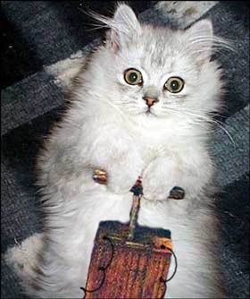
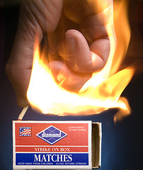
The minimum amount of energy that colliding particles must have in order to form an activated complex is called the activation energy of the reaction.
Particles that collide with less than the activation energy cannot form an activated complex.

Slide 8
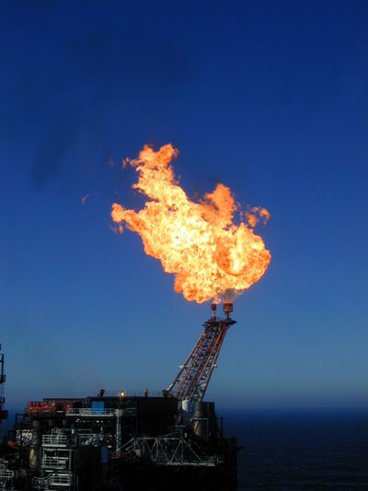
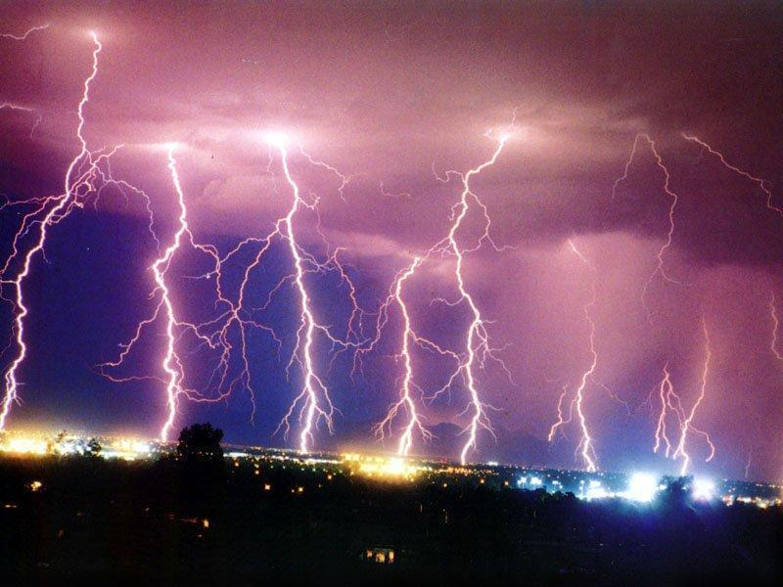
Activation Energy and Energy Diagrams
CH₄ + 2O₂ → CO₂ + 2H₂ O + Energy
N₂ + 2O₂ + Energy → 2NO₂

Slide 9
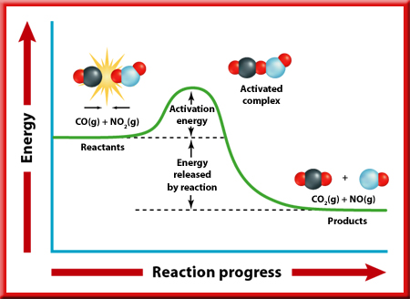
Activation Energy and Energy Diagrams
CO + NO₂ → CO₂ + NO
In an exothermic reaction, molecules collide with enough energy to overcome the activation energy barrier, form an activated complex, then release energy and form products at a lower energy level.

Slide 10
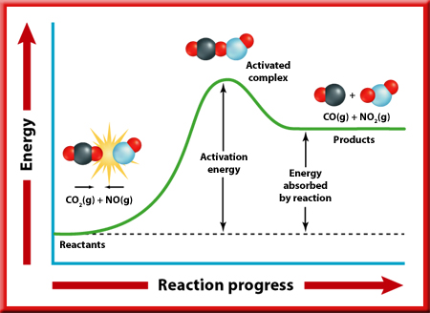
Activation Energy and Energy Diagrams
In the reverse endothermic reaction, the reactant molecules lying at a low energy level must continually absorb energy to collide with enough force to overcome the activation energy barrier and form high-energy products.
CO₂ + NO → CO + NO₂

Slide 11
Factors Affecting Reaction Rates
1. The Nature of Reactants
An important factor that affects the rate of a chemical reaction is the reactive nature of the reactants. Some substances react more readily than others.
The more reactive a substance is, the faster the reaction rate.

Slide 12
2. Concentration
Reactions speed up when the concentrations of reacting particles are increased.
Think about a reaction where reactant A combines with reactant B.
At a given concentration of A and B, the molecules of A collide with B to produce AB at a particular rate.
What happens if the amount of B is increased?
Increasing the concentration of B makes more molecules available with which A can collide.

Slide 13
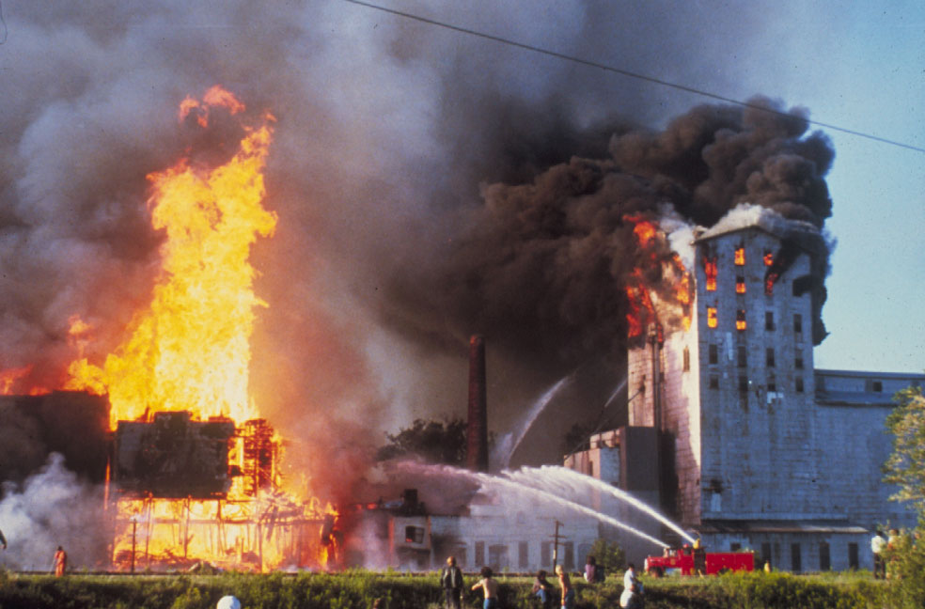
Surface Area
Increasing the surface area of reactants provides more opportunity for collisions with other reactants, thereby increasing the reaction rate.
Grain Elevator Fire
Sawdust explosion

Slide 14
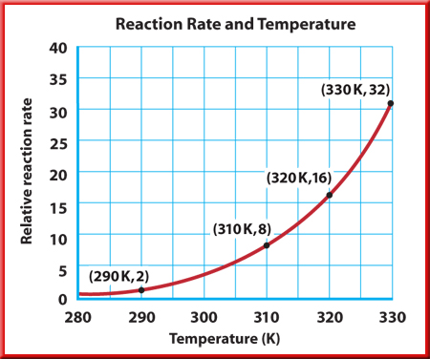
3. Temperature
Increasing the temperature of the reactants increases the reaction rate.
Why?
Because raising the kinetic energy of the reacting particles raises both the number of collisions and the energy of the collisions.
You get more collisions that have the needed activation energy.

Slide 15
4. Catalysts
Many chemical reactions in living organisms would not occur quickly enough to sustain life at normal living temperatures if it were not for the presence of enzymes.
An enzyme is a type of catalyst, a substance that increases the rate of a chemical reaction without itself being consumed in the reaction.
Although catalysts are important substances in a chemical reaction, a catalyst does not yield more product and is not included in the product(s) of the reaction.

Slide 16
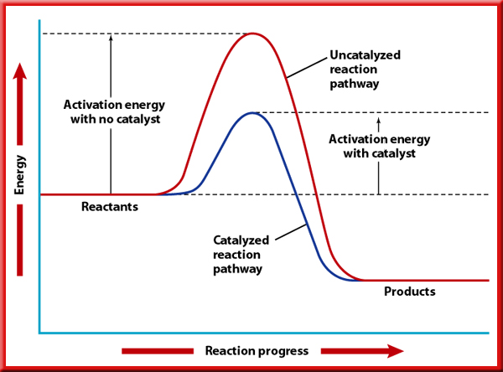
Energy Diagram with Catalyst
A catalyst works by lowering the activation energy of the reaction.

Slide 17
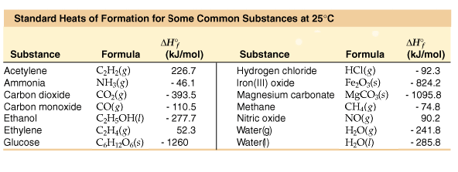

Slide 18
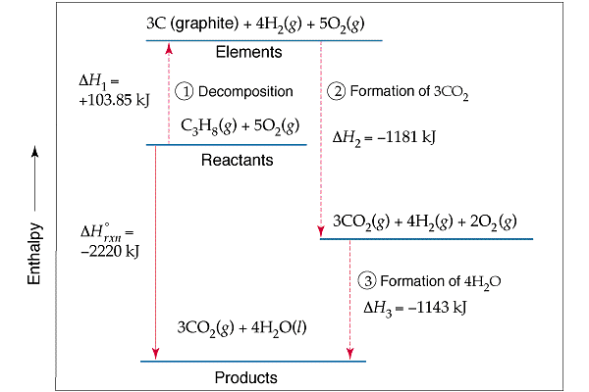

Slide 19
EX1 Calculate the ΔH for:
2 Na(s) + 2 H₂O(l) → 2 NaOH(aq) + H₂(g) ΔH = ?
ΔH_{f}’s: -286 kJ -470 kJ
EX2 Calculate the ΔH for:
C₆H₁₂O₆(s) + 6 O₂(g) → 6 CO₂(g) + 6 H₂O(l) ΔH = ?
ΔH_{f}’s: -1273 kJ -394 kJ -286 kJ

Slide 20
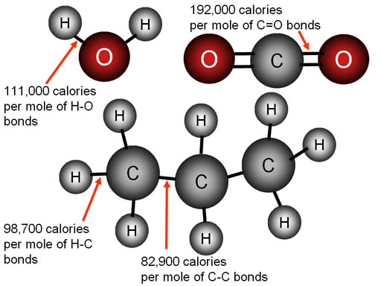
Using Bond Energies to Calculate ∆H_{rxn}

Slide 21
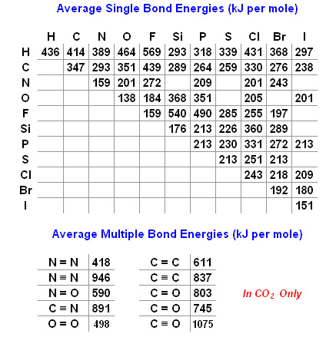

Slide 22
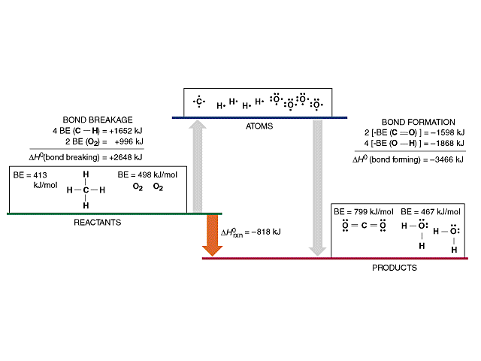

Slide 23
Calculate ∆H for the following reactions using the given bond energies (in kJ/mol):
EX2 NH₃ + 3 Cl₂ → NCl₃ + 3 HCl
BE: N-H 391 Cl-Cl 242 N-Cl 200 H-Cl 431
EX3 HCN + 3 H₂ → CH₄ + NH₃
BE: H-C 413 C=N 891 H-H 436 C-H 413
_

